Slide 1

Ang Cui | ang@cs.columbia.edu

Slide 2


Slide 3


Slide 4

With Zack Newman zjn2101@columbia.edu

Slide 5
Last year…
Win!

Slide 8

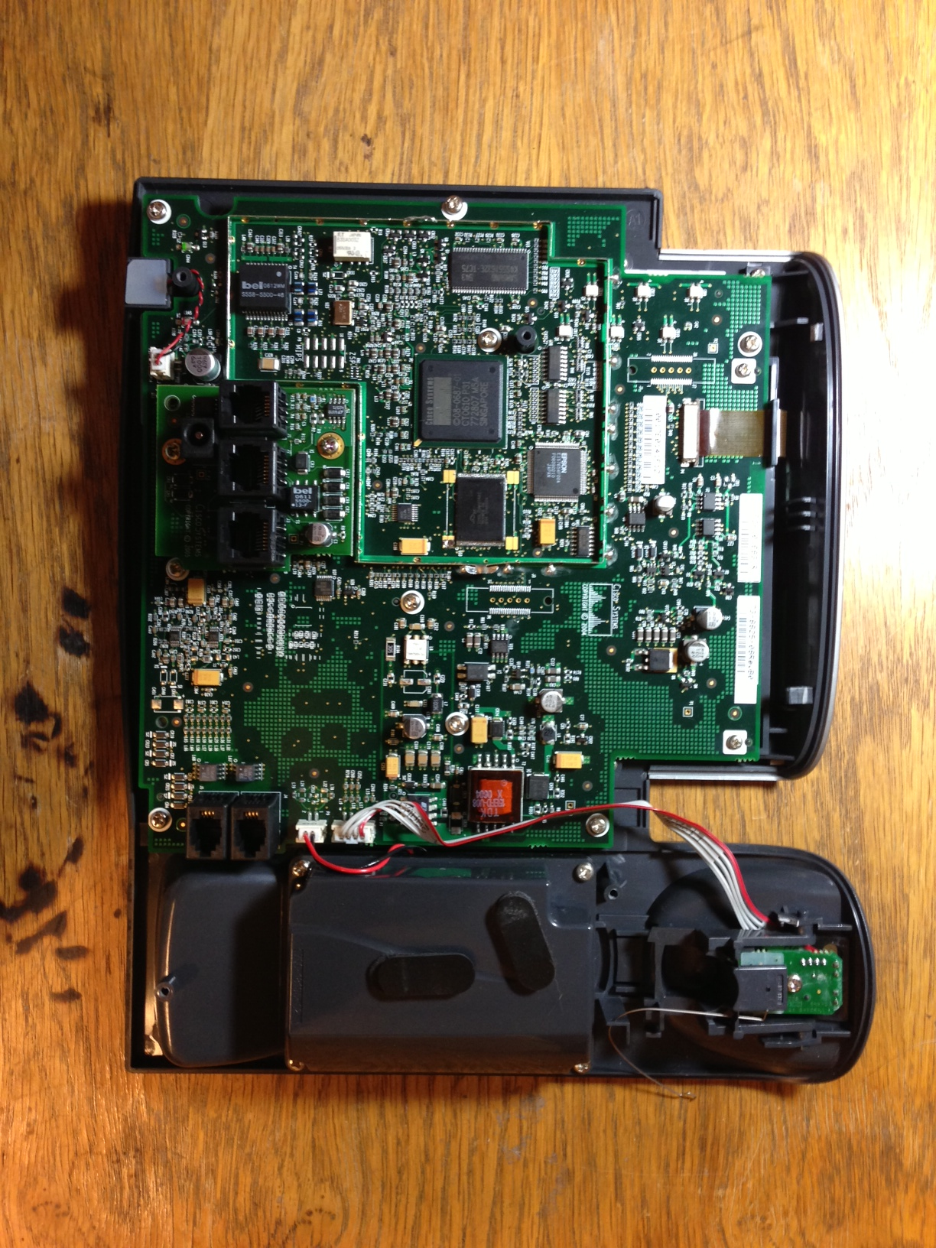

Slide 9
Funtenna
Noun:
1: Software payload that intentionally causes its host hardware to act as an improvised RF transmitter using existing hardware, which are typically not designed for electromagnetic emanation.
2: Software which intentionally causes compromising emanation.

Slide 10
Prior Art
SigInt Awesomesauce, et. al
TEMPEST Timeline: http://cryptome.org/tempest-time.htm

Slide 11

Peter Wright
MI5 Counter Intelligence
Author: Spycatcher

Slide 12


t

Slide 13
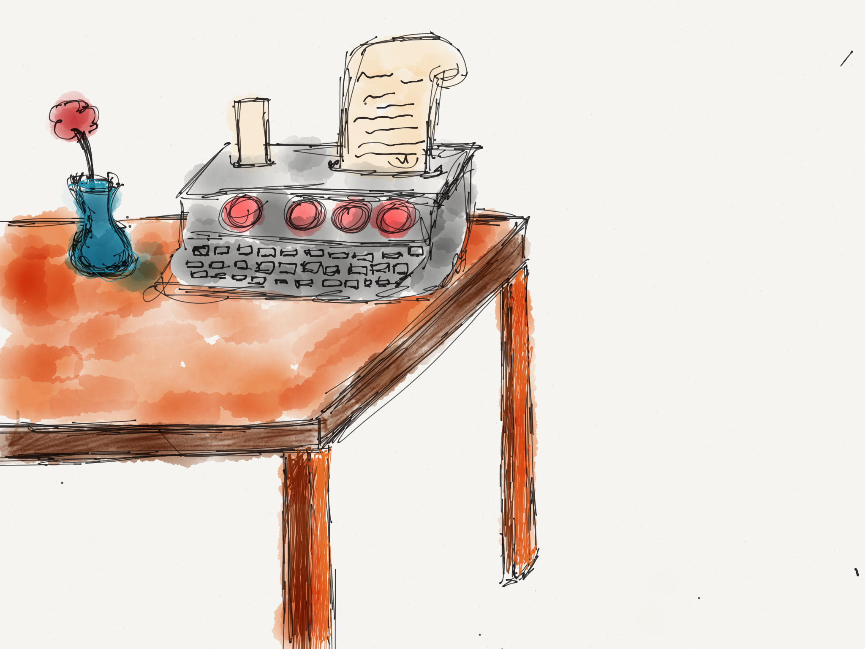

Slide 14


Slide 15


Slide 16
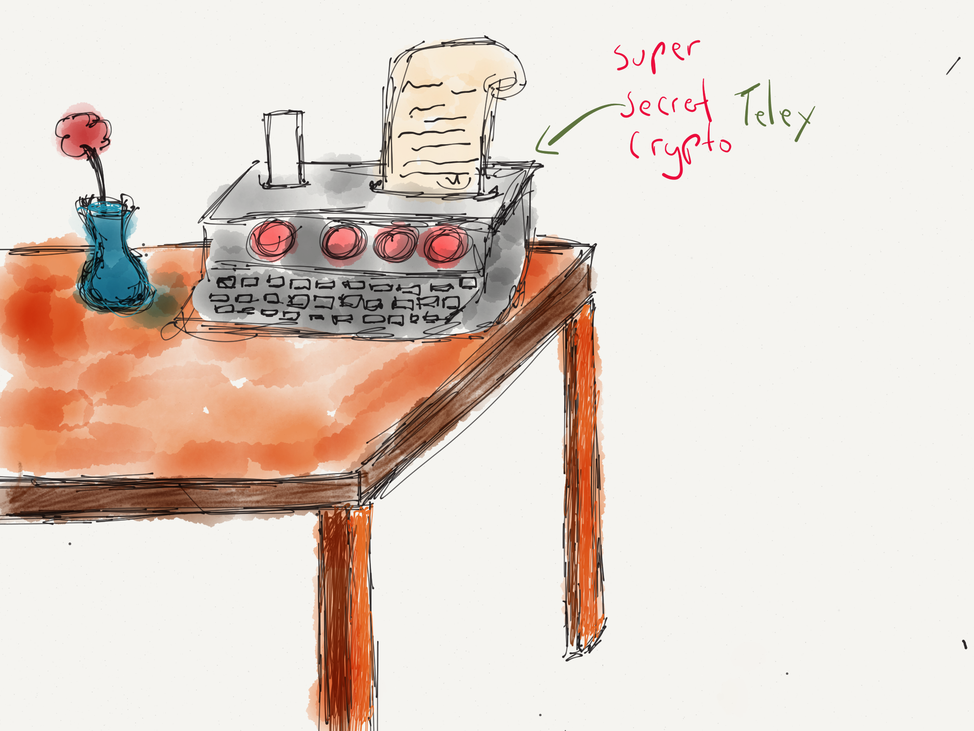

Slide 17
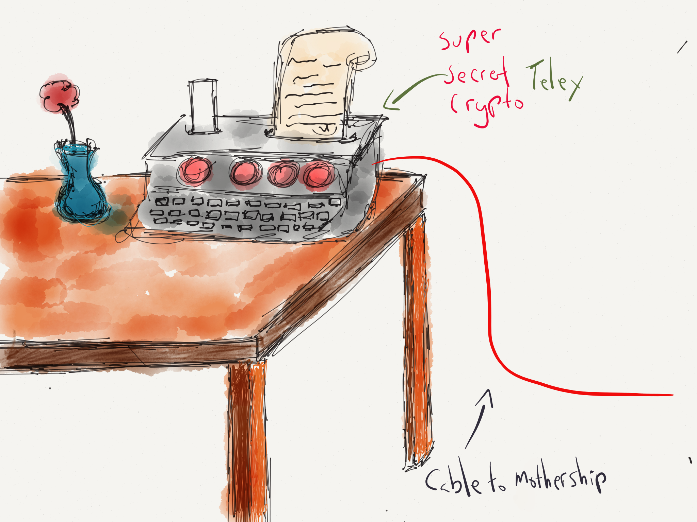

Slide 18
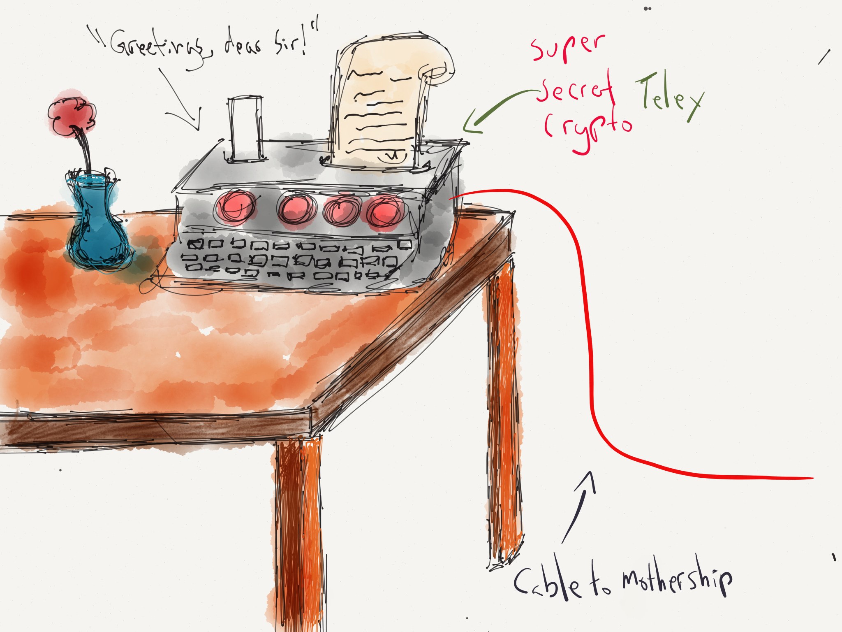

Slide 19


Slide 20


Slide 21
Prior Art
SigInt Awesomesauce, et. al
Van Eck Phreaking, etc

Slide 22
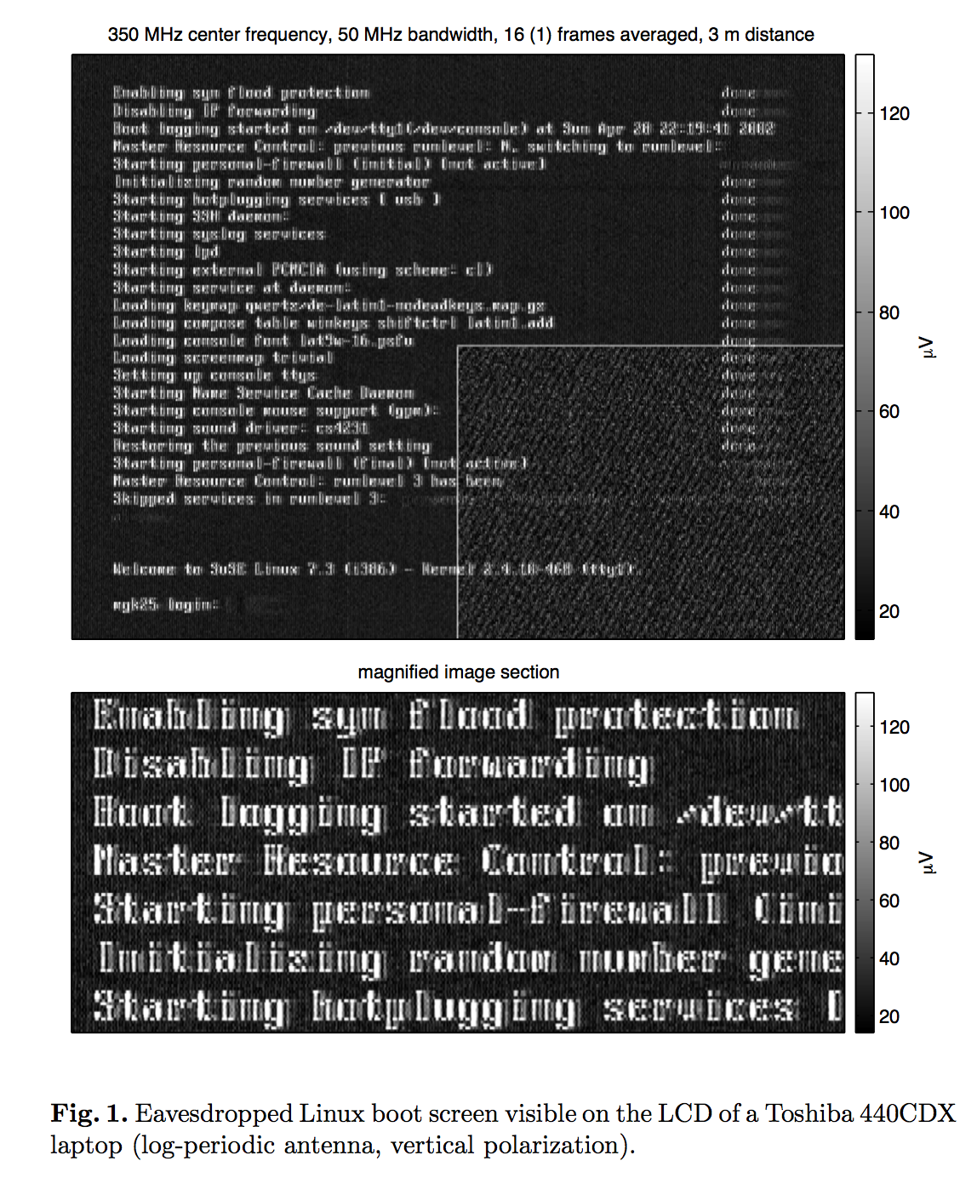
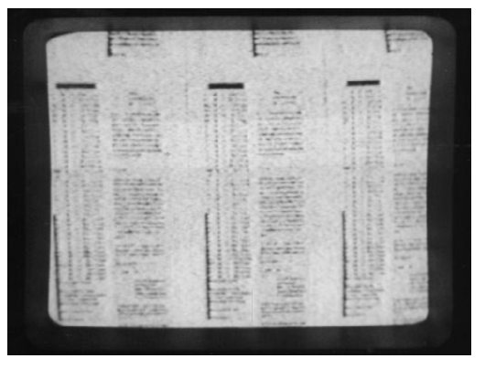
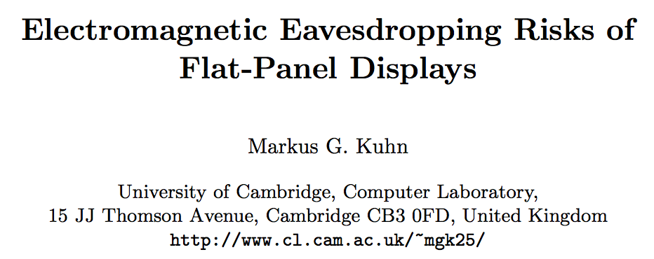
Prior Art

Slide 23
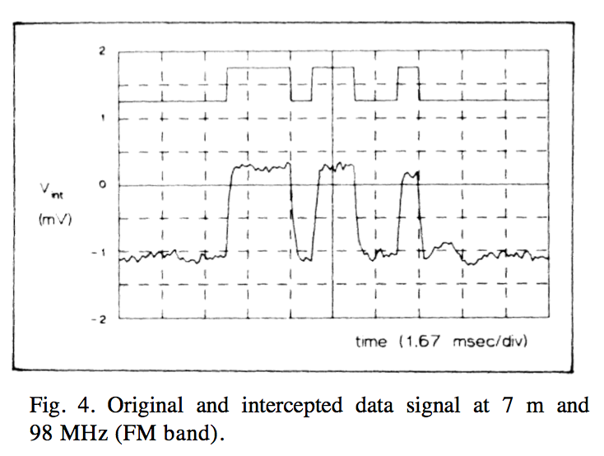
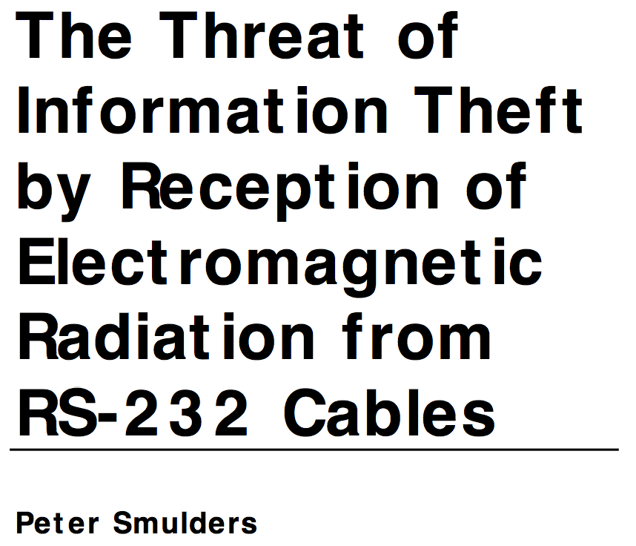
Prior Art

Slide 24
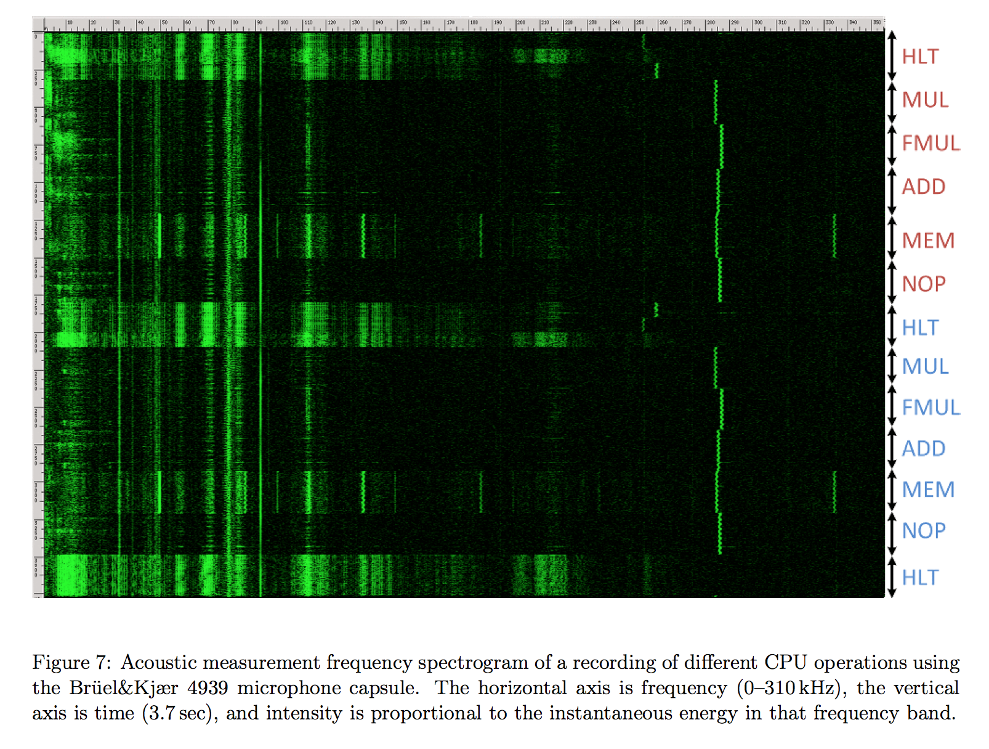
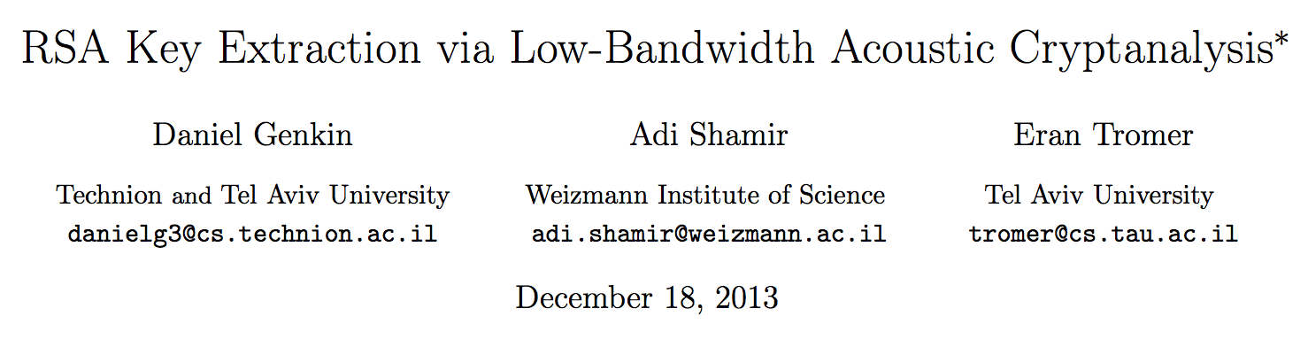
Prior Art

Slide 25
Funtenna p0c
Reference implementation to demonstrate feasibility

Slide 26
Funtenna p0c
Reference implementation to demonstrate feasibility
Open hardware & software
Use hardware found on nearly all embedded devices

Slide 27
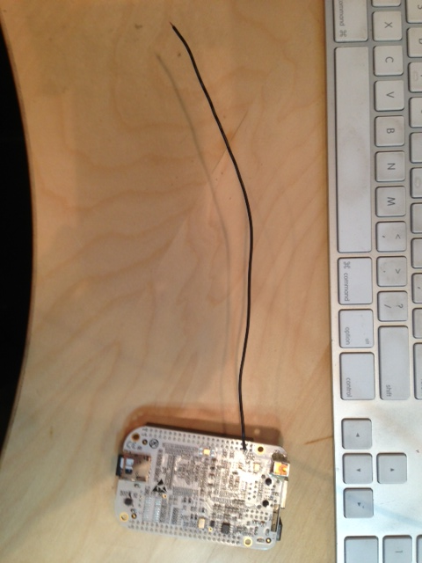
Funtenna p0c
Reference implementation to demonstrate feasibility
Open hardware & software
Use hardware found on nearly all embedded devices
BeagleBone - GPIO

Slide 28


Slide 34
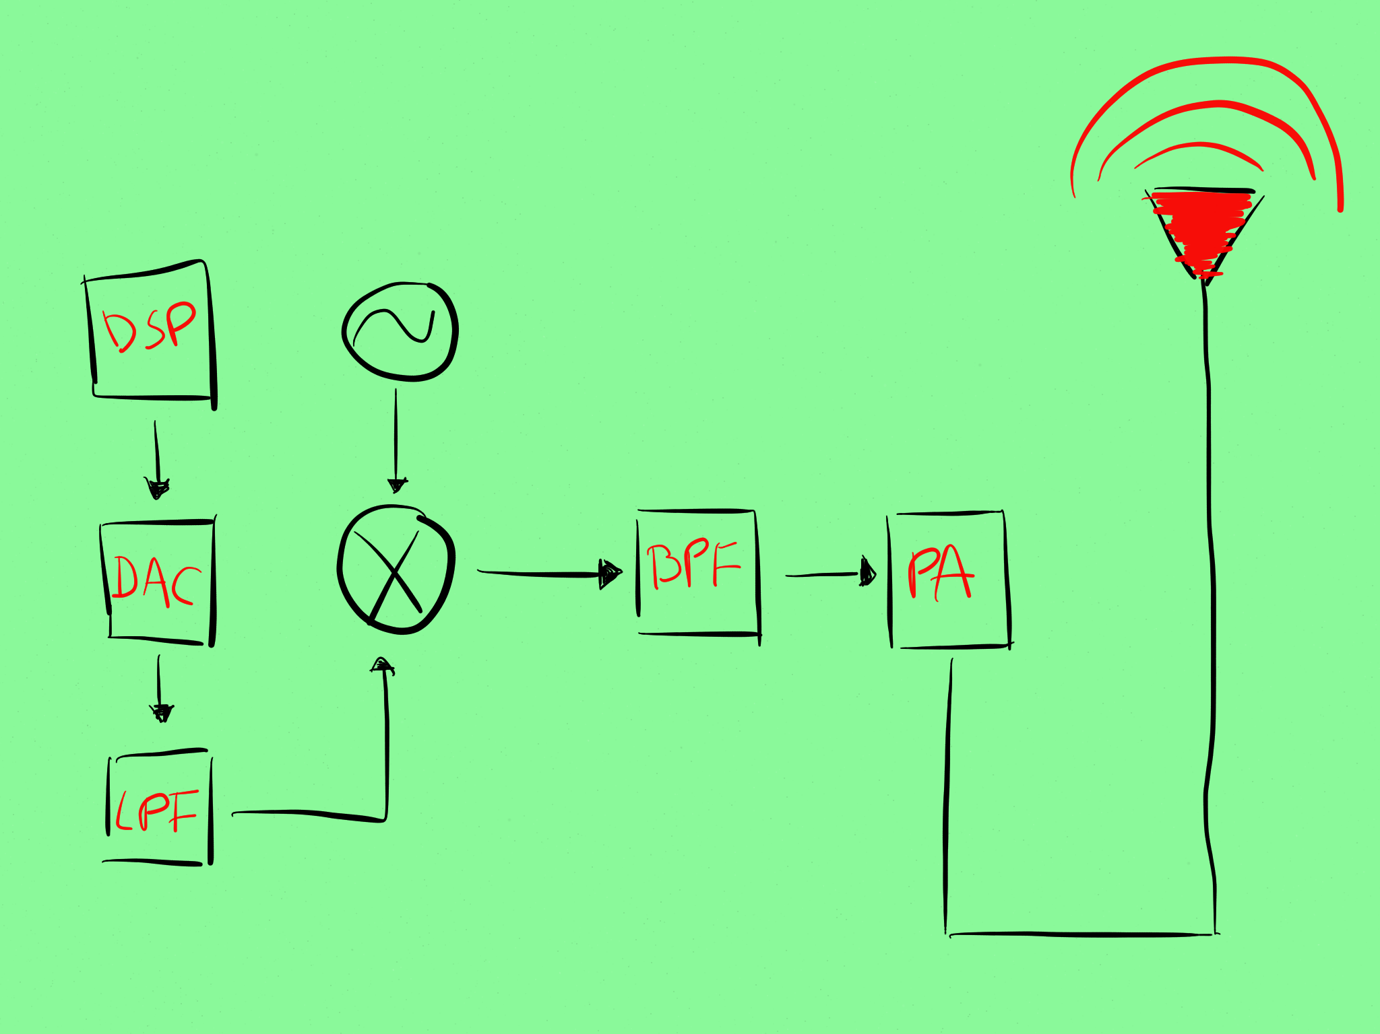

Slide 41
DAC?

Slide 42
DAC?
Wire…

Slide 43
LPF?

Slide 44
LPF?
Wire…

Slide 45
Oscillator?

Slide 46
Oscillator?
sorta…

Slide 47
Power Amp?

Slide 48
Power Amp?
Wire…

Slide 49
BPF?

Slide 50
BPF?
Wire…

Slide 51
Antenna?
Wire!

Slide 52

Funtenna p0c

Slide 53
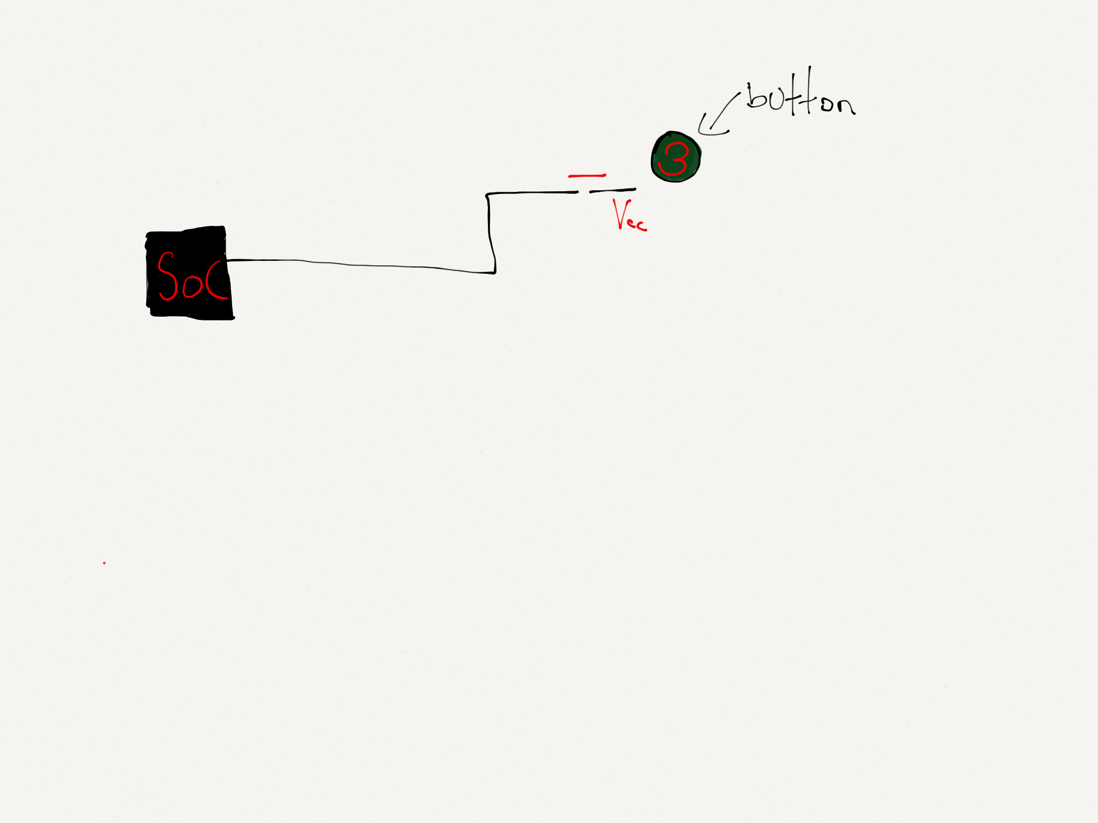
Funtenna p0c

Slide 54
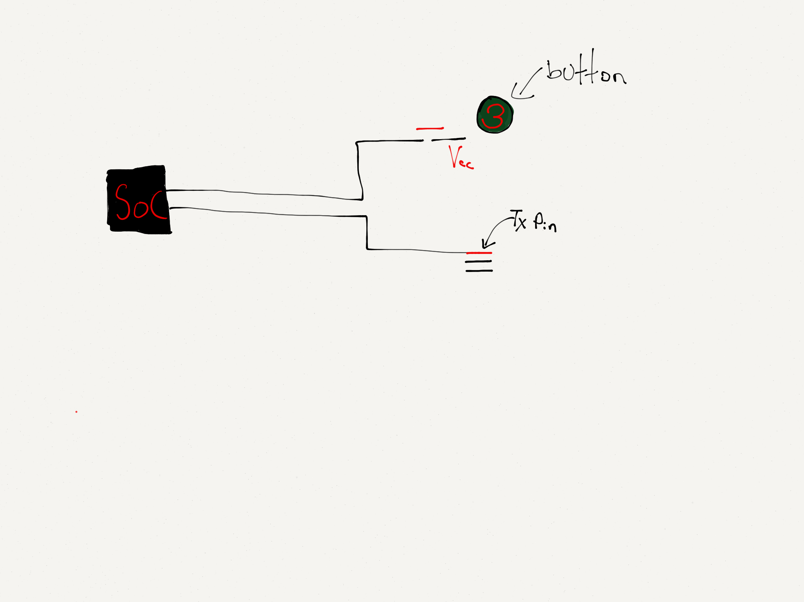
Funtenna p0c

Slide 55
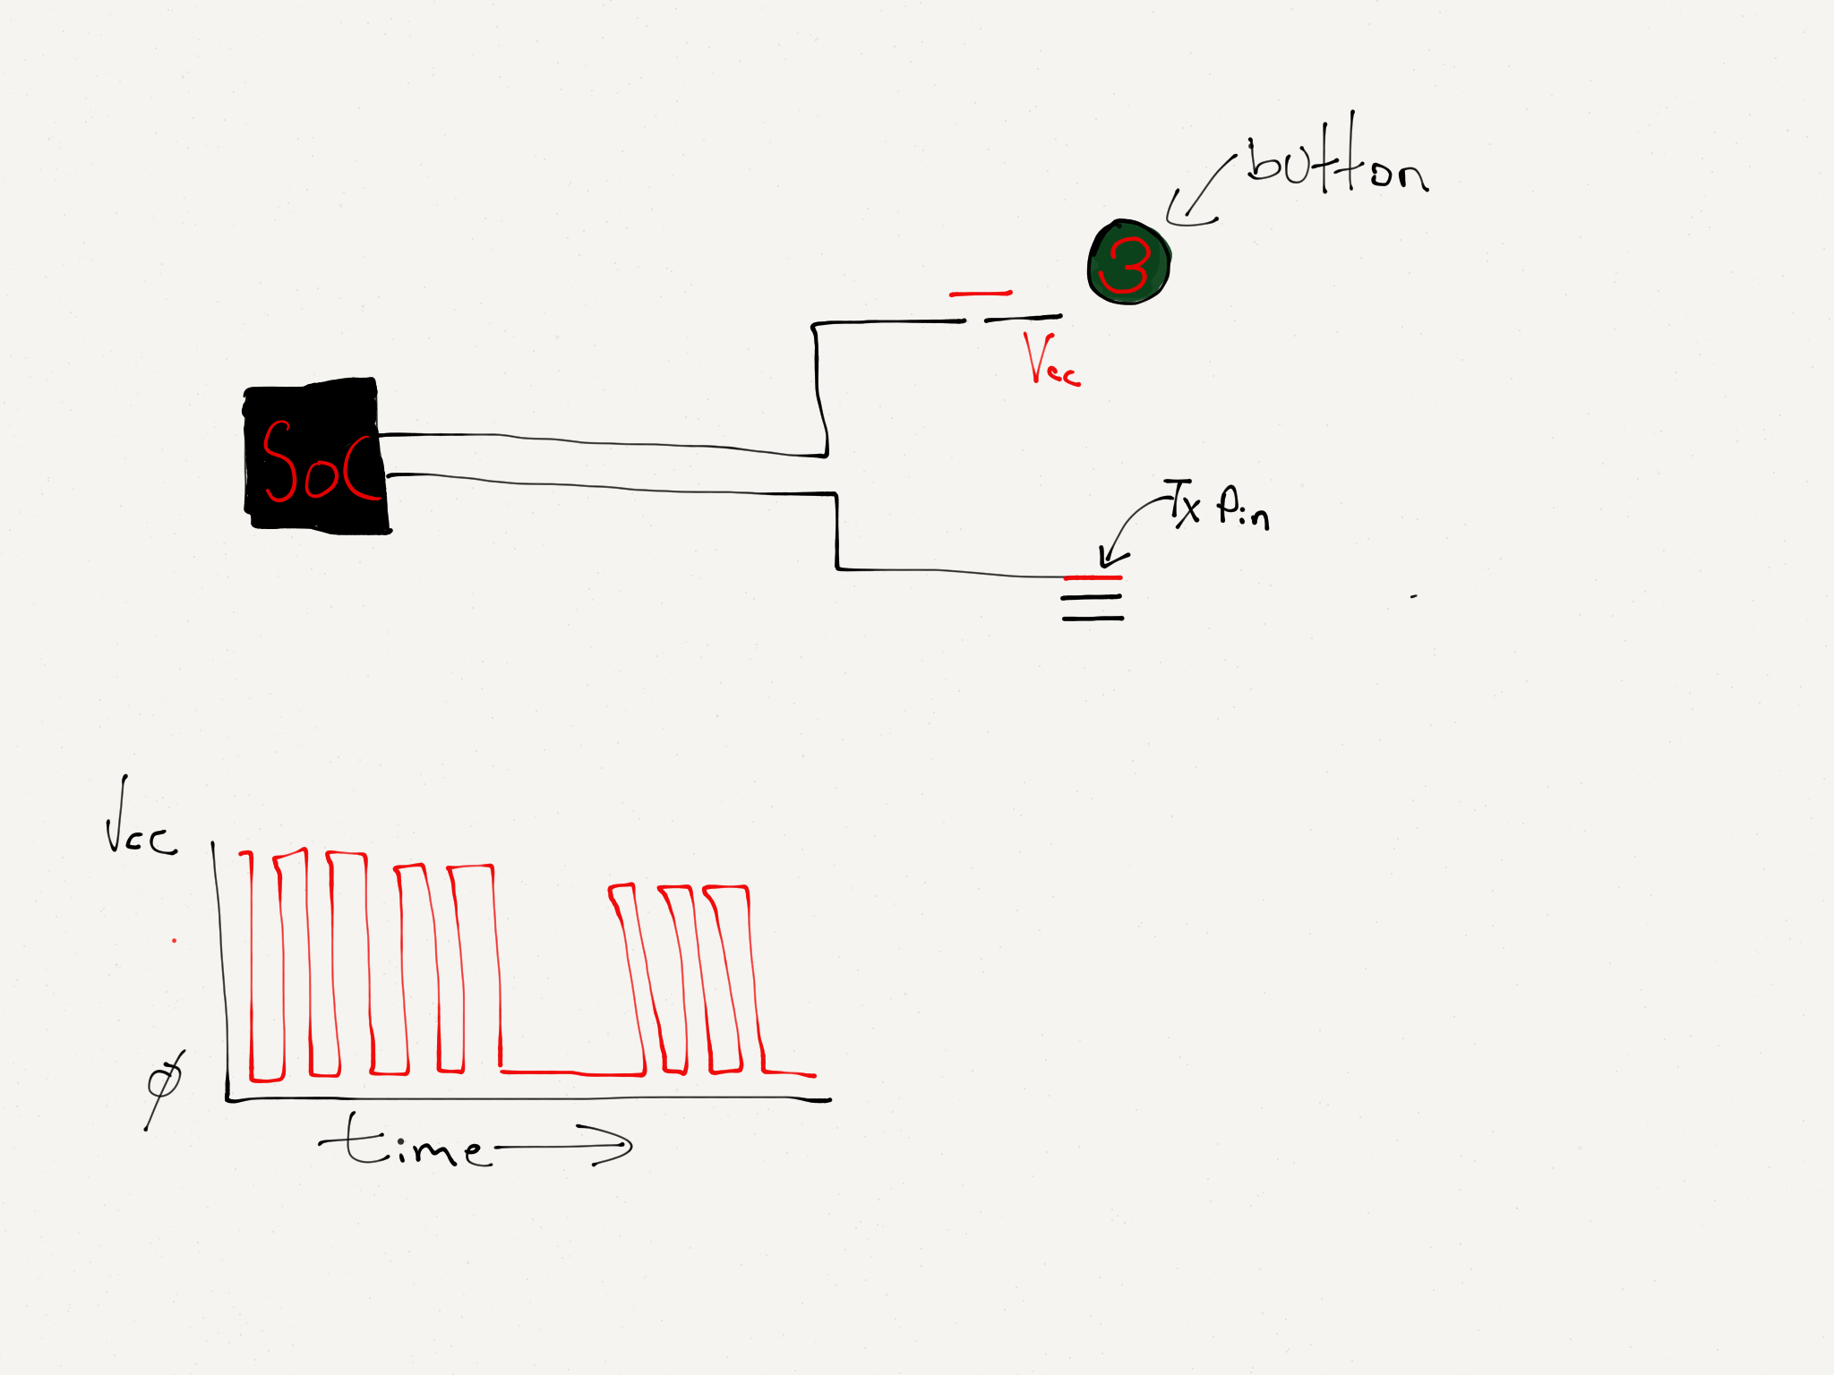
Funtenna p0c

Slide 56
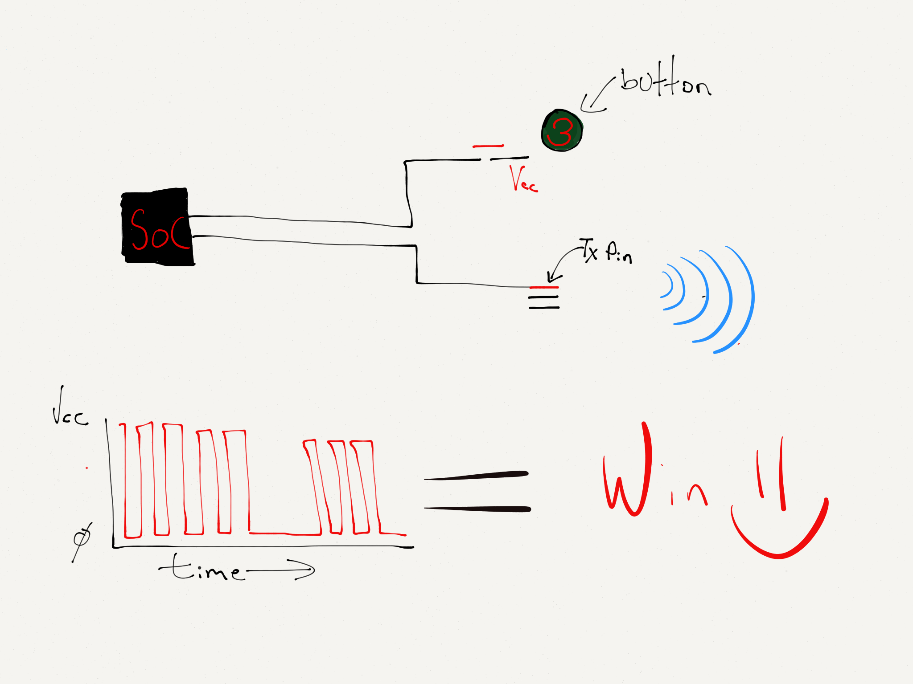
Funtenna p0c

Slide 57
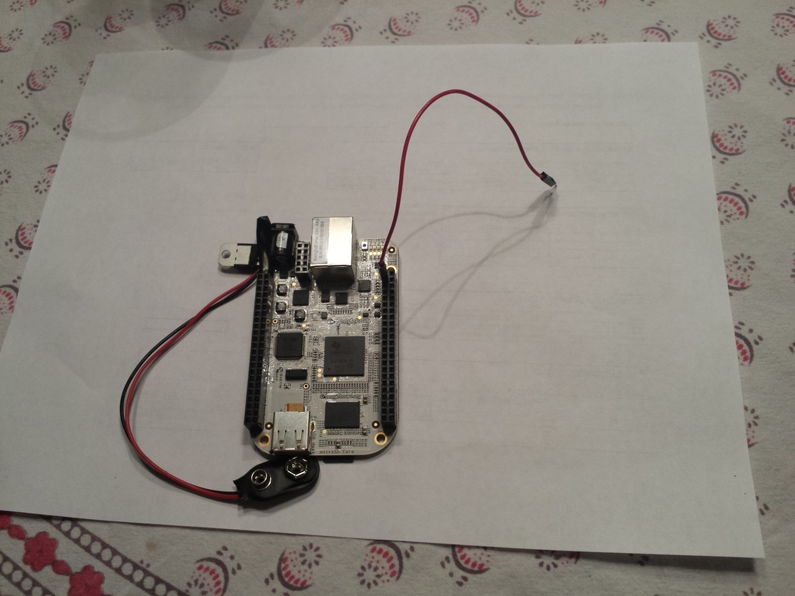
Reference Implementation

Slide 58


Slide 59
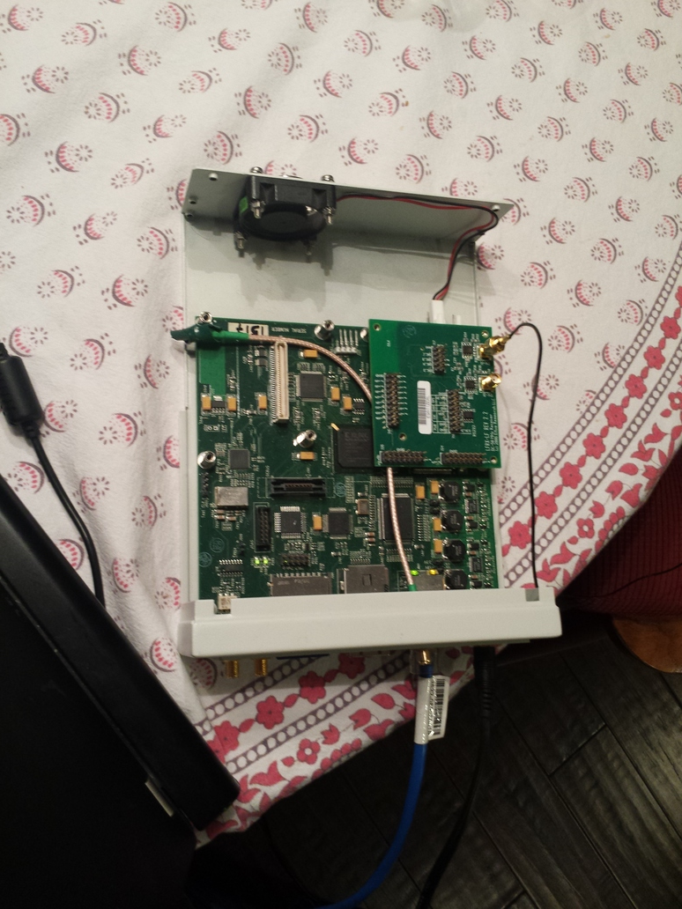
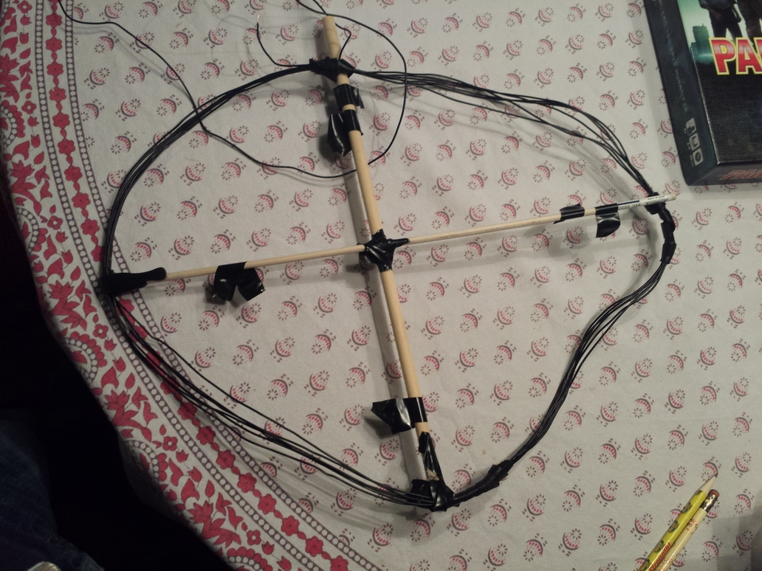
Reference Implementation

Slide 60
DEMO

Slide 61

On-Off Keying

Slide 62
On-Off Keying
100,000 cycles / bit

Slide 63
Message Format
Prologue: 11001100
Message length
Hamming[7,4] code with extra parity bit

Slide 64
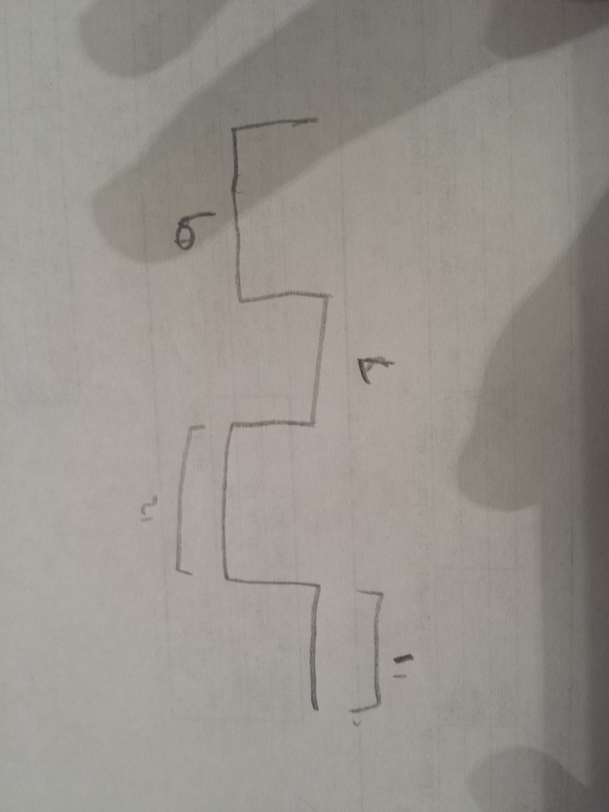
Results: Irregular Symbol Duration
12 ms
9 ms
7 ms
11ms
12

Slide 65
Results: Sample Drift

Slide 66
Results: Bandwidth
12.5 MHz at 100,000 cycles / bit
= 125 bits / sec
~= 16 bytes / sec

Slide 67
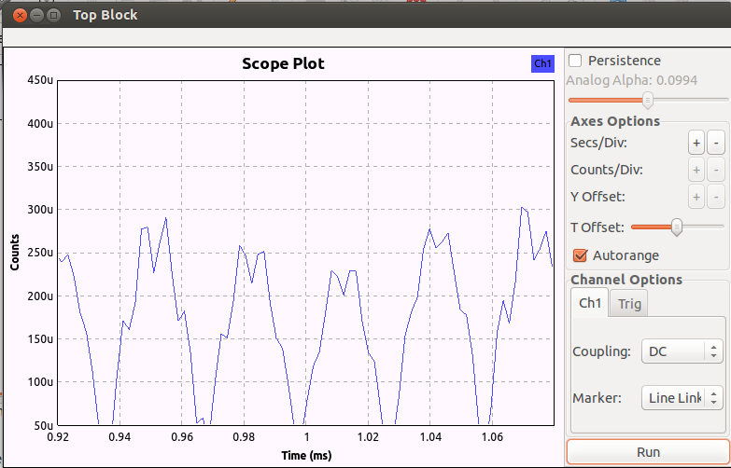
Theoretical Bandwidth
1,500 cycles / bit
~= 8.3 kbit / sec

Slide 68
Other Improvements
Frequency Shift Keying
Protocol improvements:
Packets of fixed size (fix sample drift; a little more efficient)
Regulate duration better

Slide 69
Funtenna p0c meets reality

Slide 70
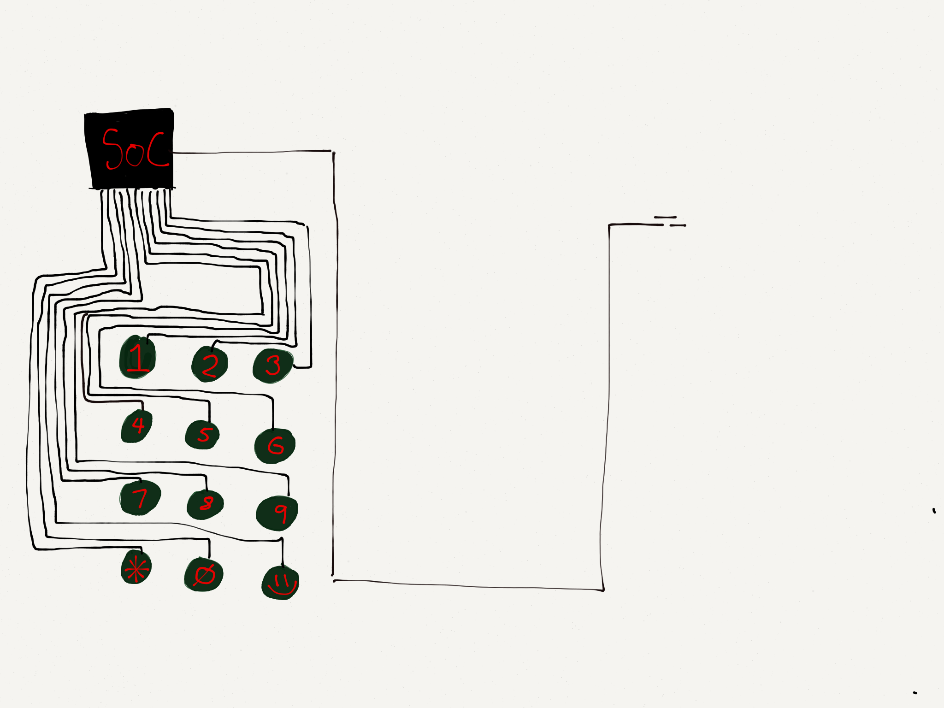
Would be so nice if GPIO worked this way…

Slide 71
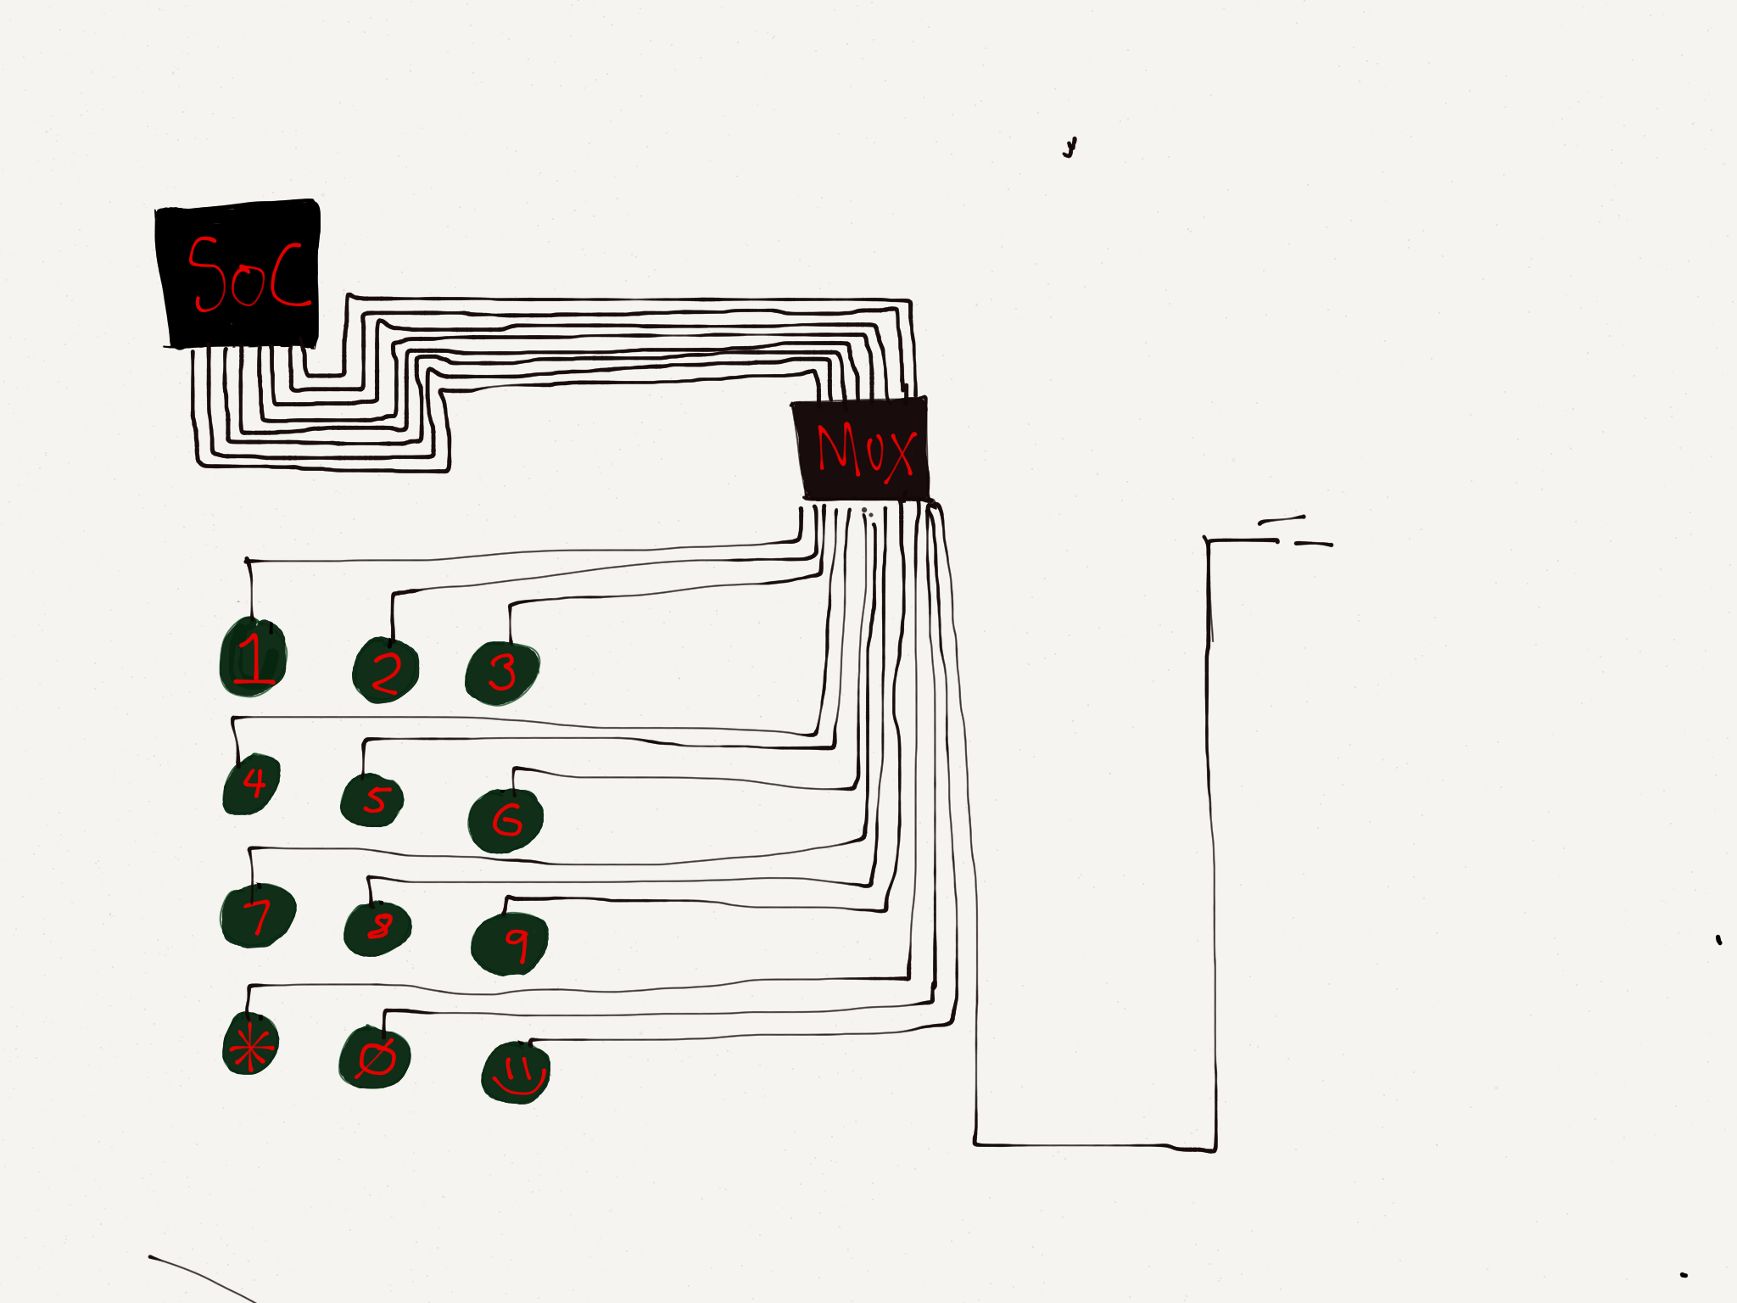
But GPIO input usually MUX’d

Slide 72
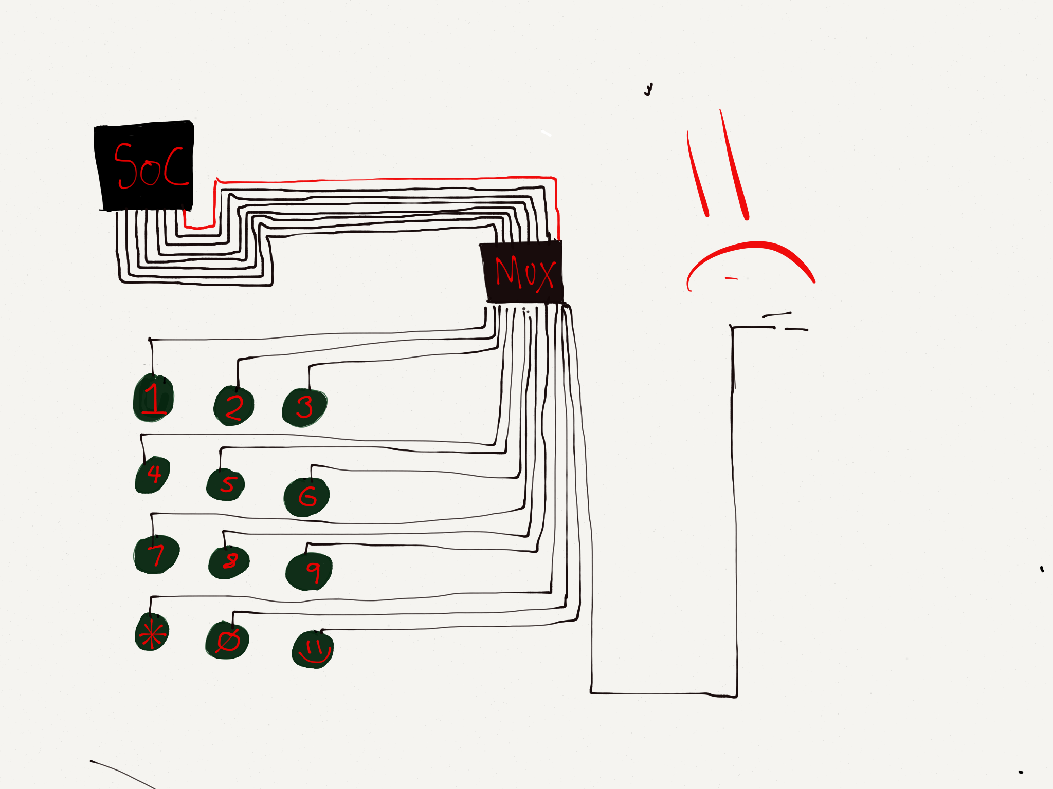
But GPIO input usually MUX’d

Slide 73
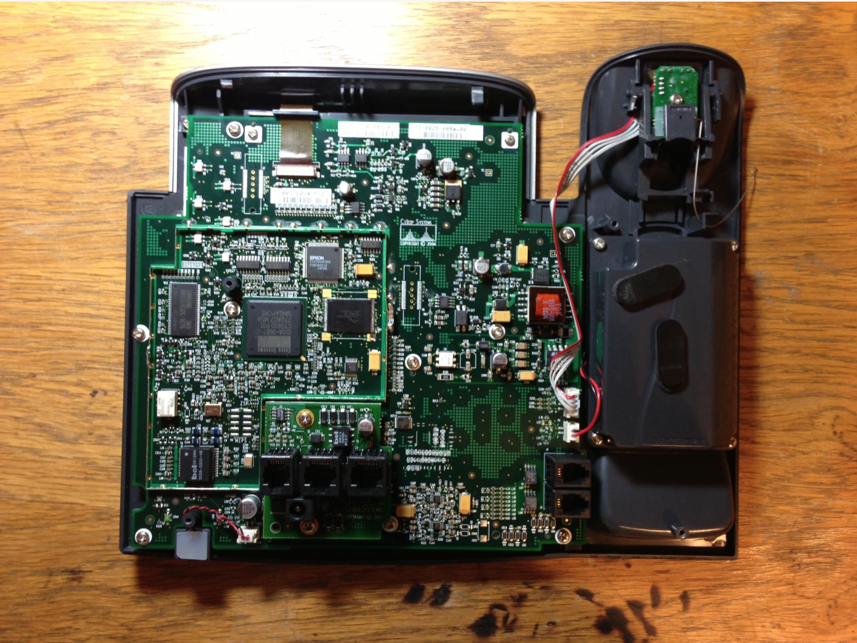

Slide 74
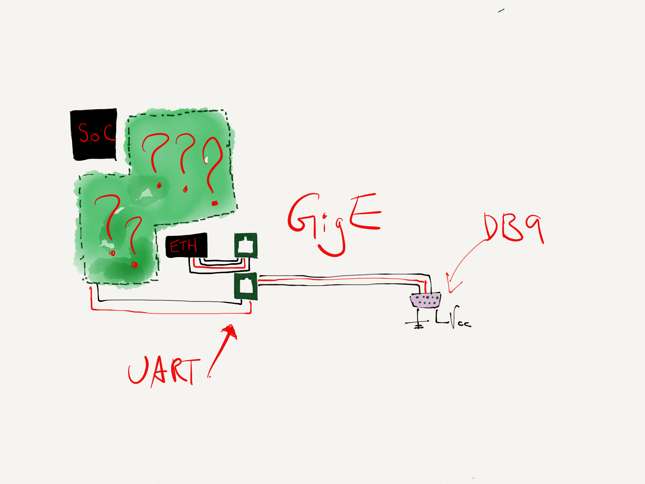

Slide 75
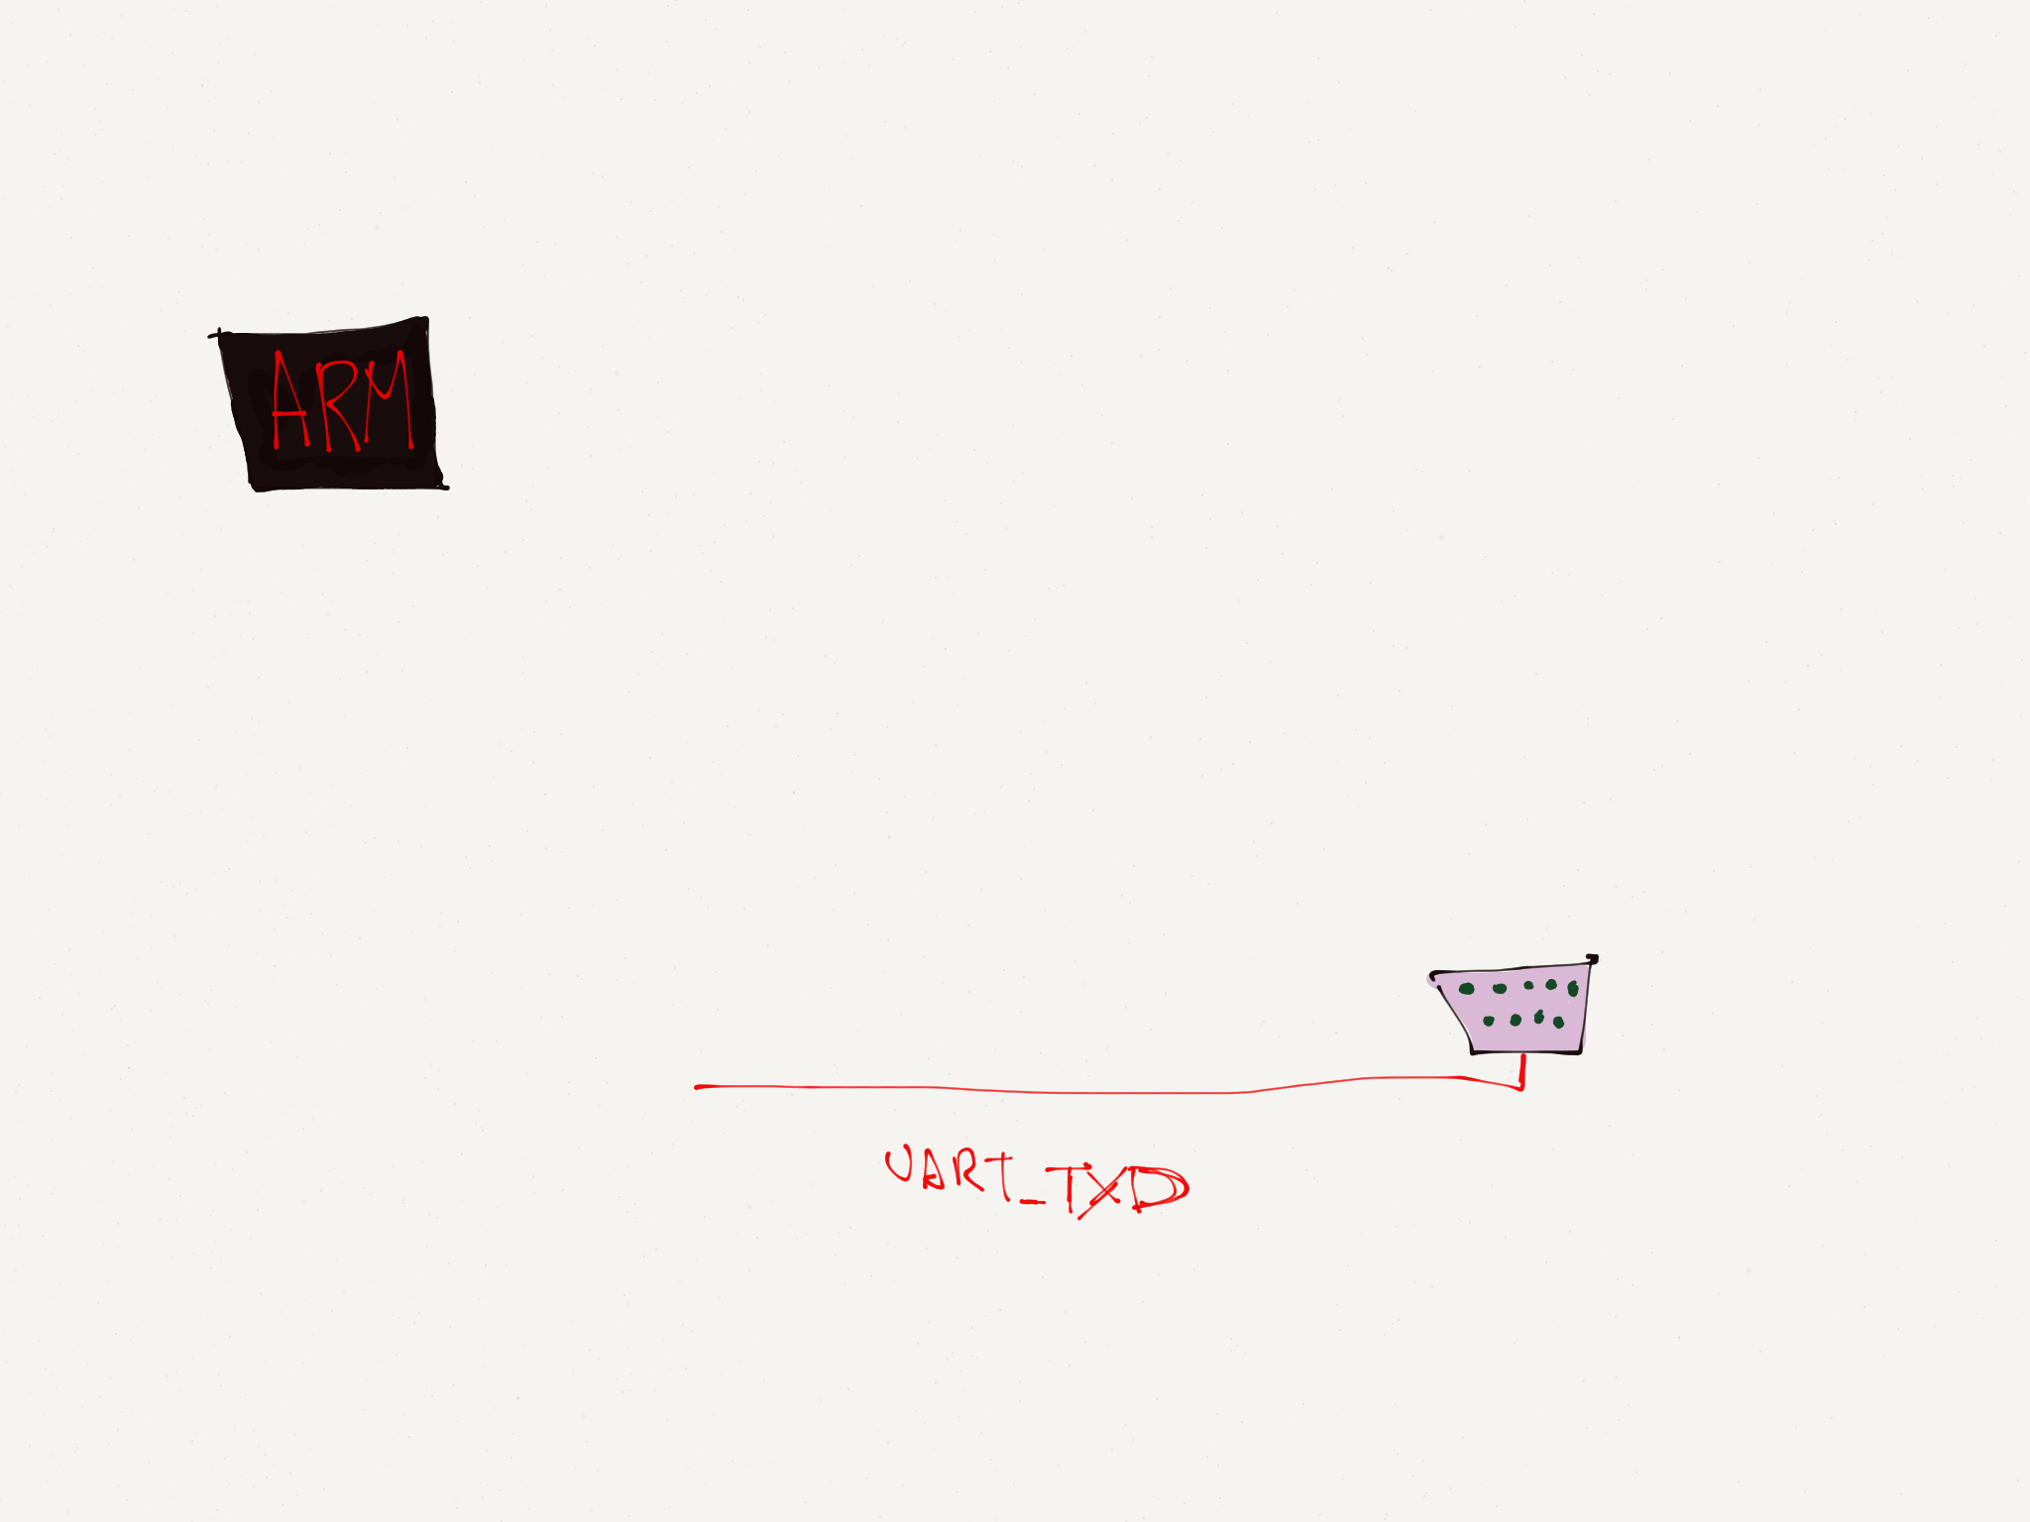
ARM / Linux / PL011 UART EXAMPLE

Slide 76
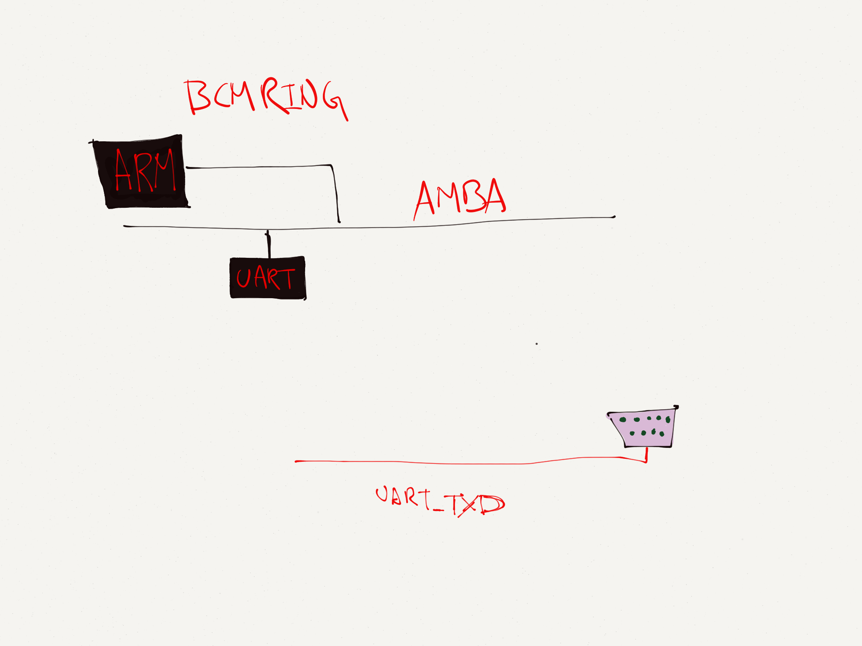
ARM / Linux / PL011 UART EXAMPLE
AMBA: Advanced Microcontroller Bus Architecture

Slide 77
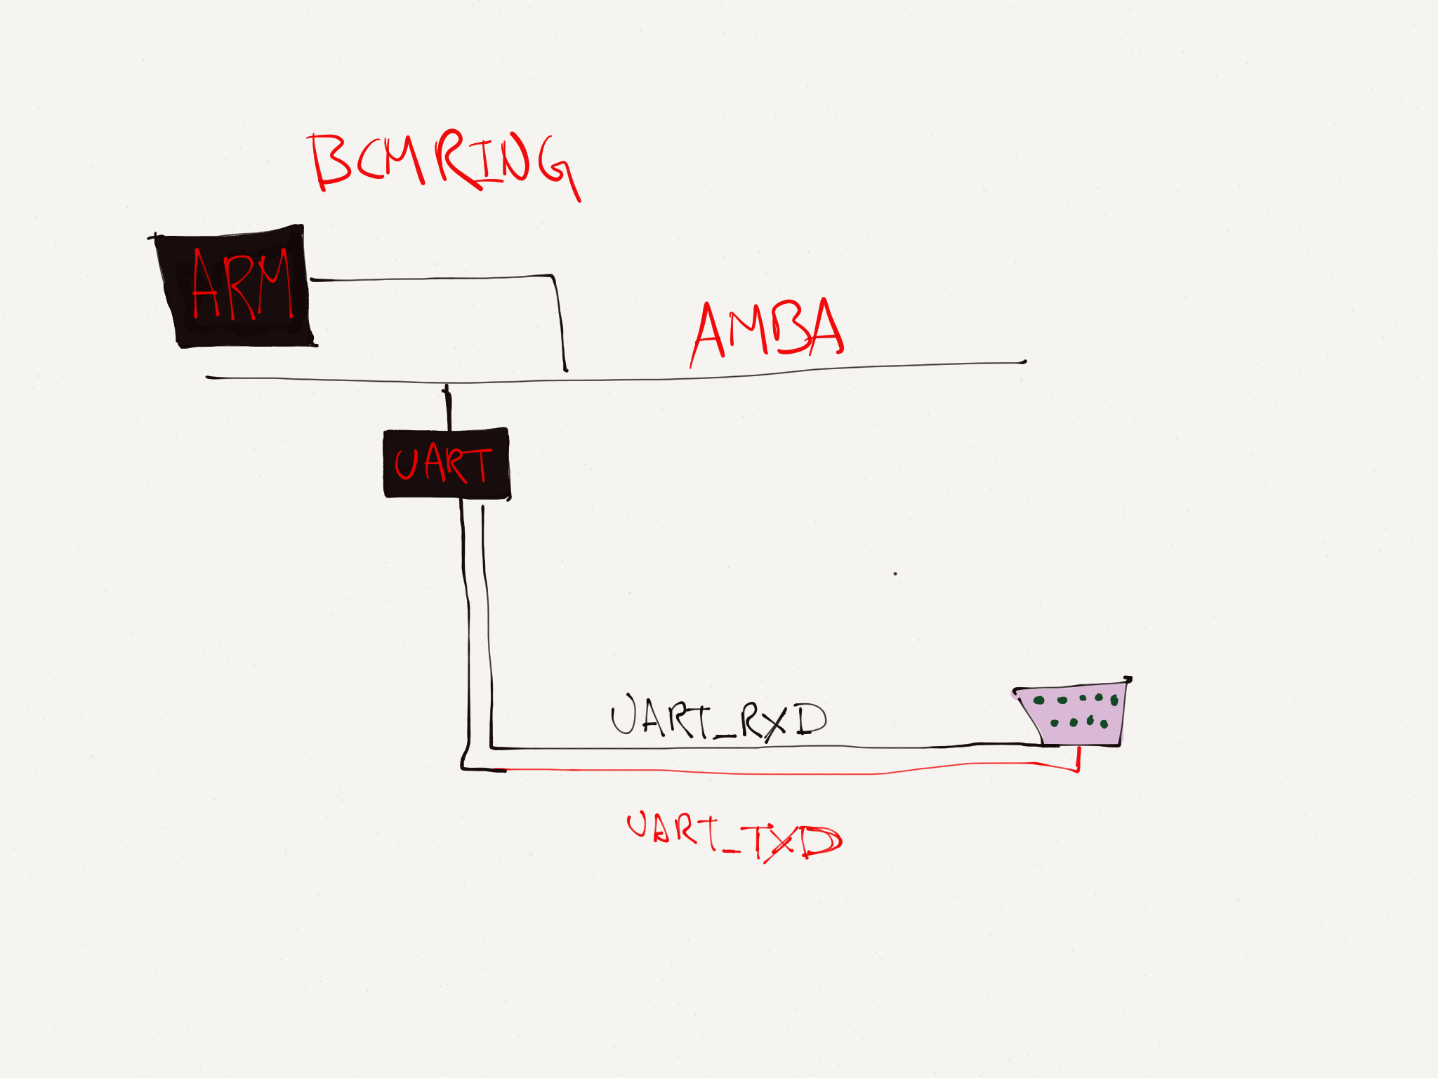
ARM / Linux / PL011 UART EXAMPLE

Slide 78
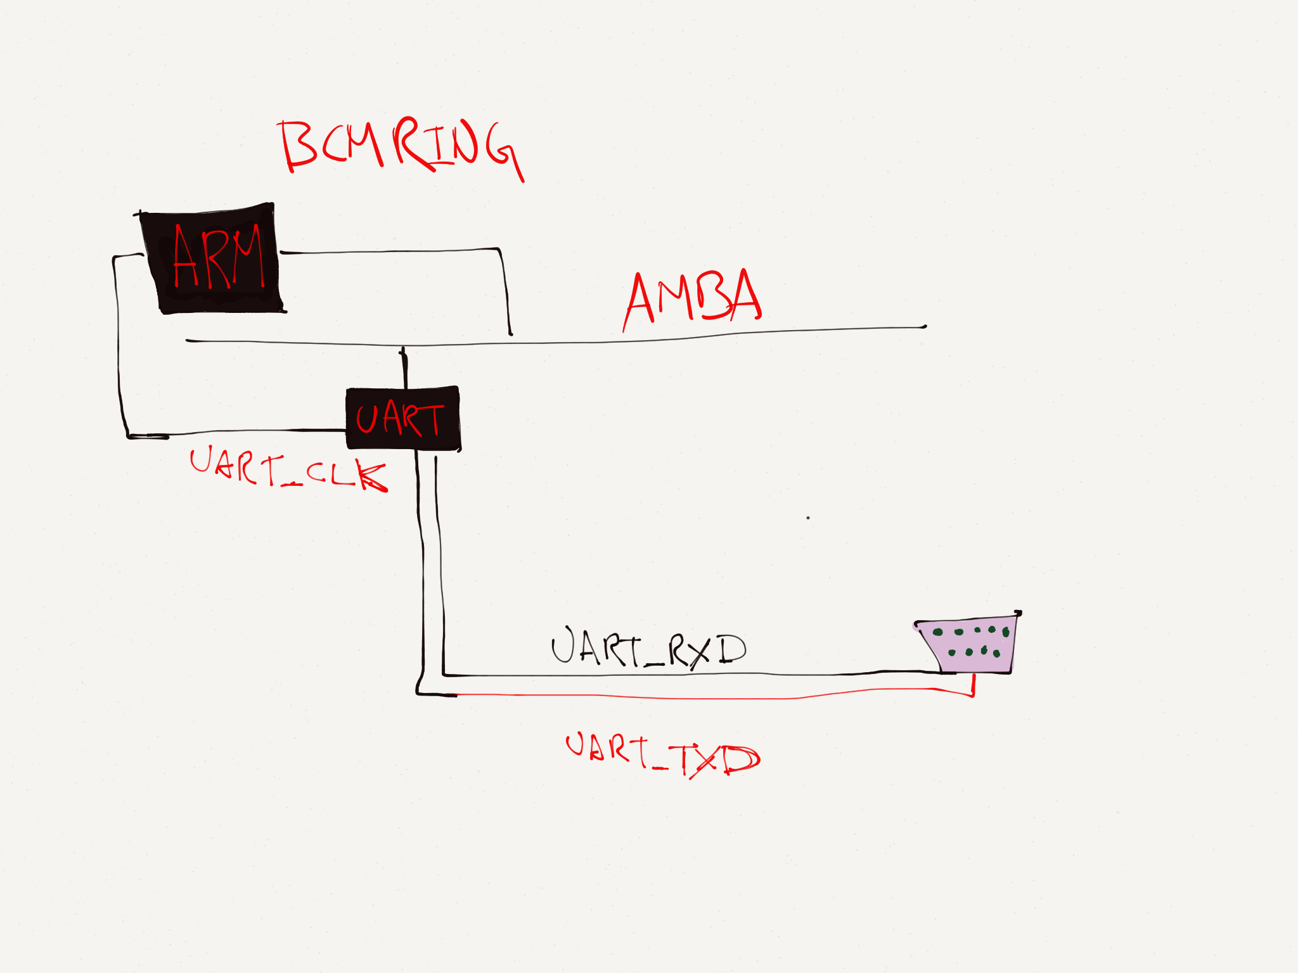
ARM / Linux / PL011 UART EXAMPLE

Slide 79
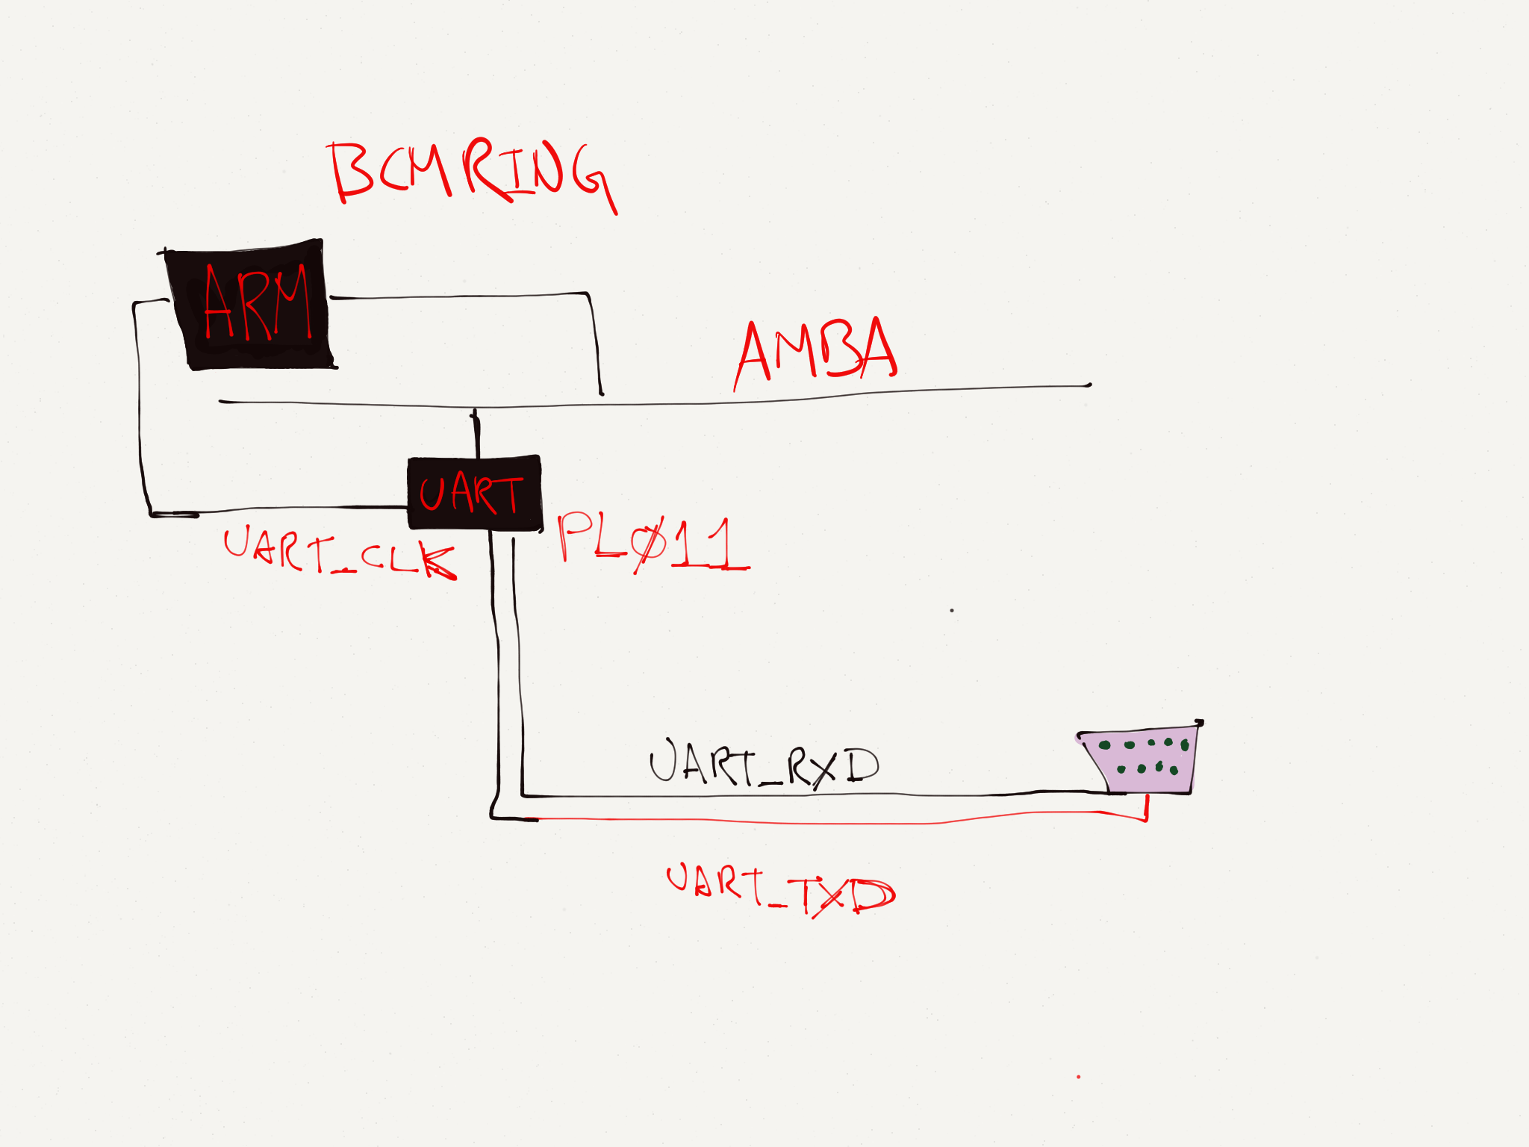
ARM / Linux / PL011 UART EXAMPLE
PL011 Datasheet http://infocenter.arm.com/help/topic/com.arm.doc.ddi0183f/DDI0183.pdf
Notes:
http://infocenter.arm.com/help/topic/com.arm.doc.ddi0183f/DDI0183.pdf

Slide 80
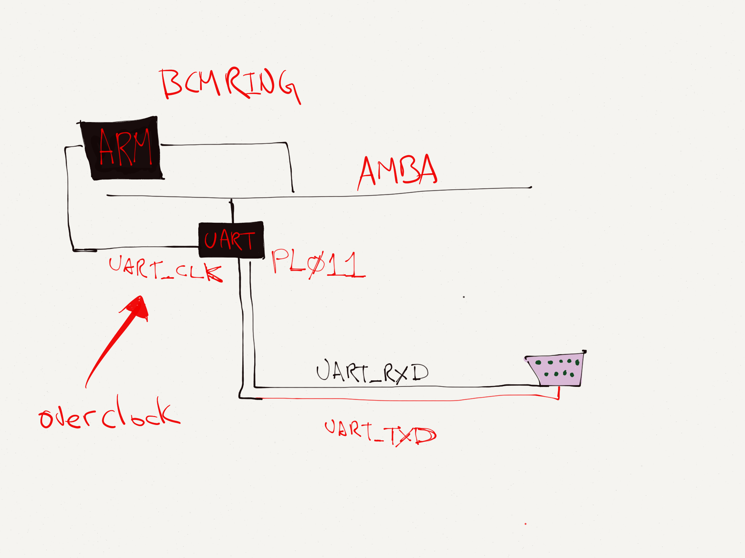
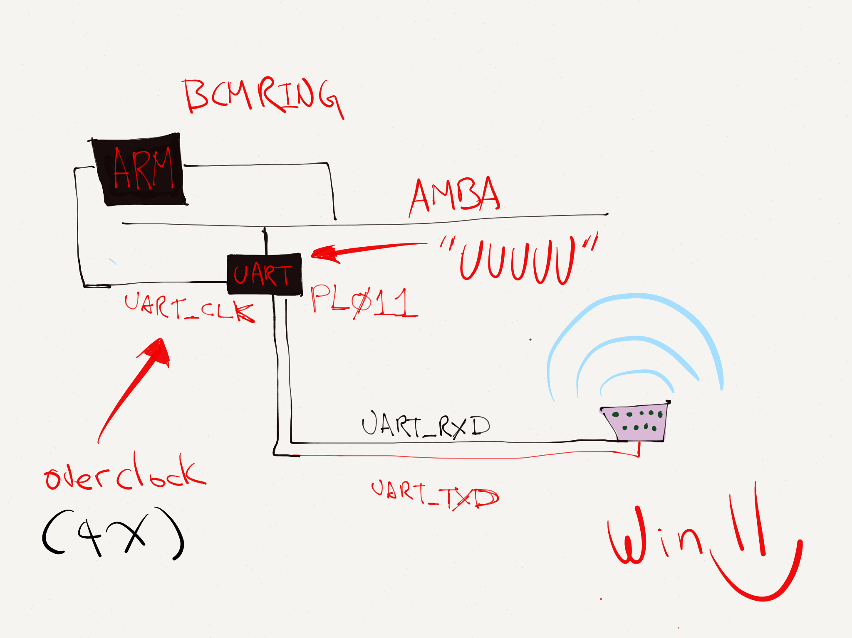
ARM / Linux / PL011 UART EXAMPLE

Slide 81
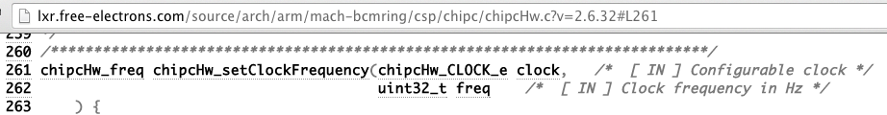
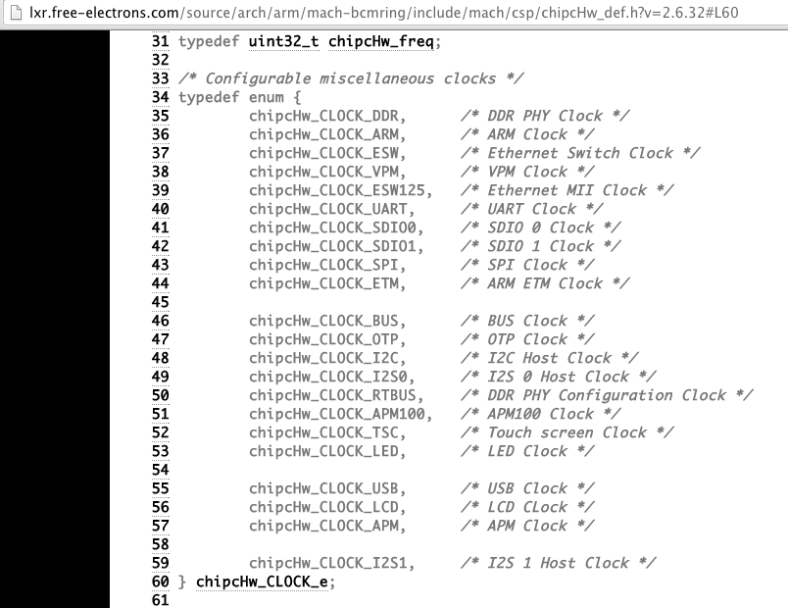
CLOCK_UART = 0x5

Slide 82
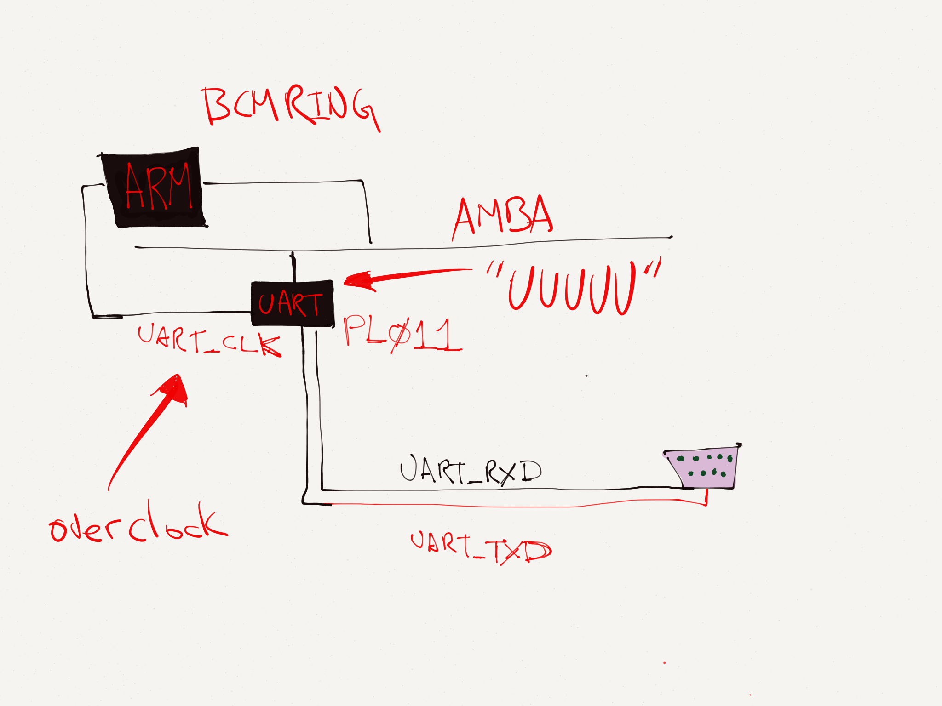
ARM / Linux / PL011 UART EXAMPLE

Slide 83
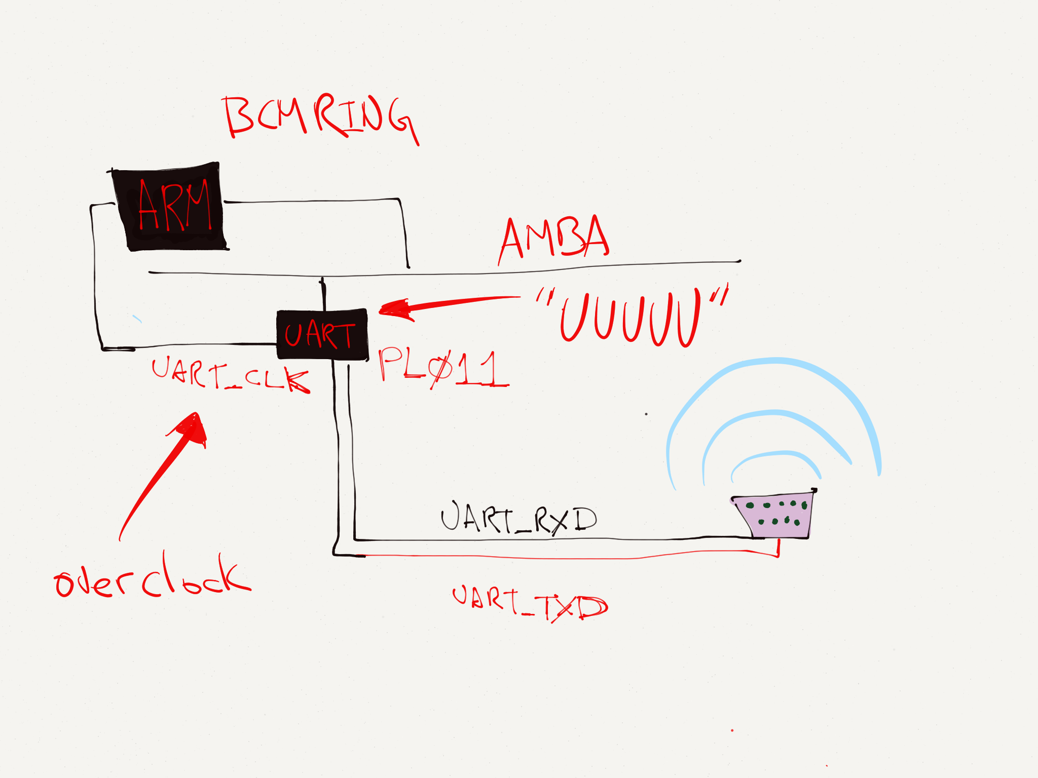
ARM / Linux / PL011 UART EXAMPLE

Slide 84

ARM / Linux / PL011 UART EXAMPLE

Slide 85
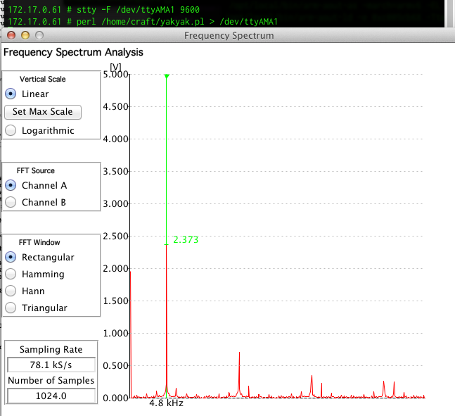
UART Funtenna 9600 baud

Slide 86
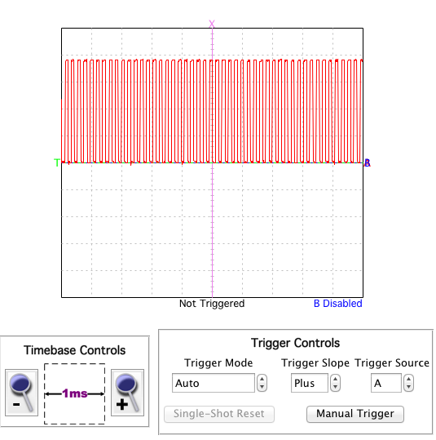
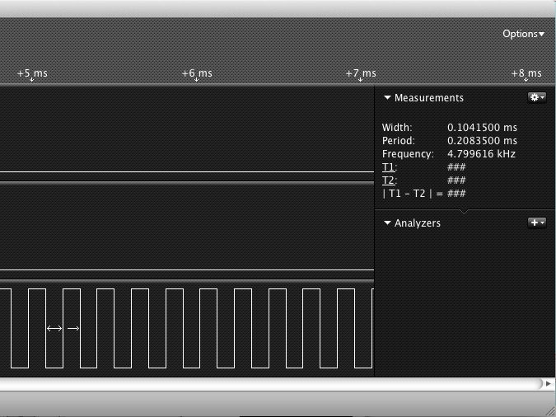
UART Funtenna 9600 baud
“UUUUUUUUUUUUU”

Slide 87
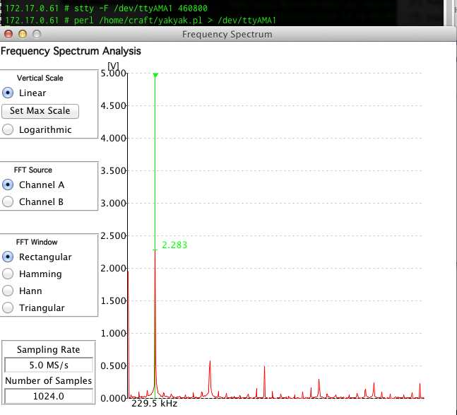
UART Funtenna 460800 baud

Slide 88
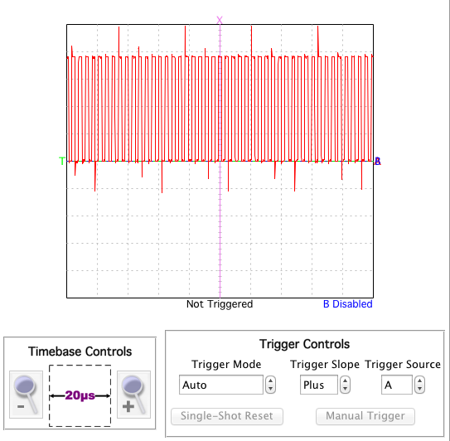
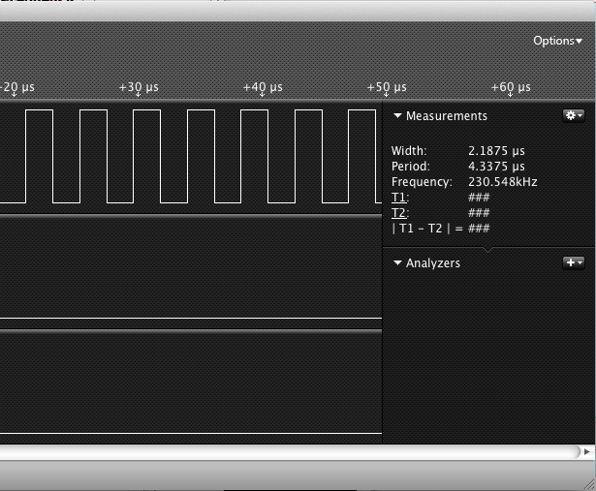
UART Funtenna 460800 baud
“UUUUUUUUUUUUU”

Slide 89
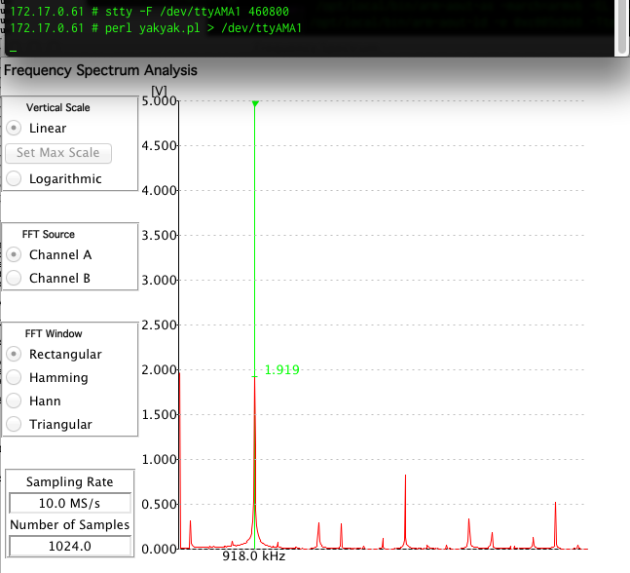
UART Funtenna “1843200” baud

Slide 90
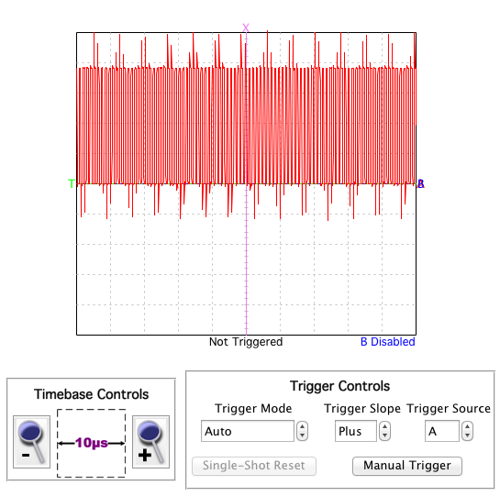
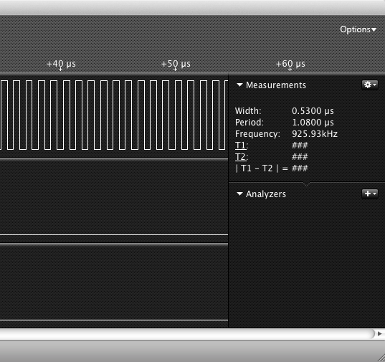
UART Funtenna “1843200” baud
“UUUUUUUUUUUUU”

Slide 91
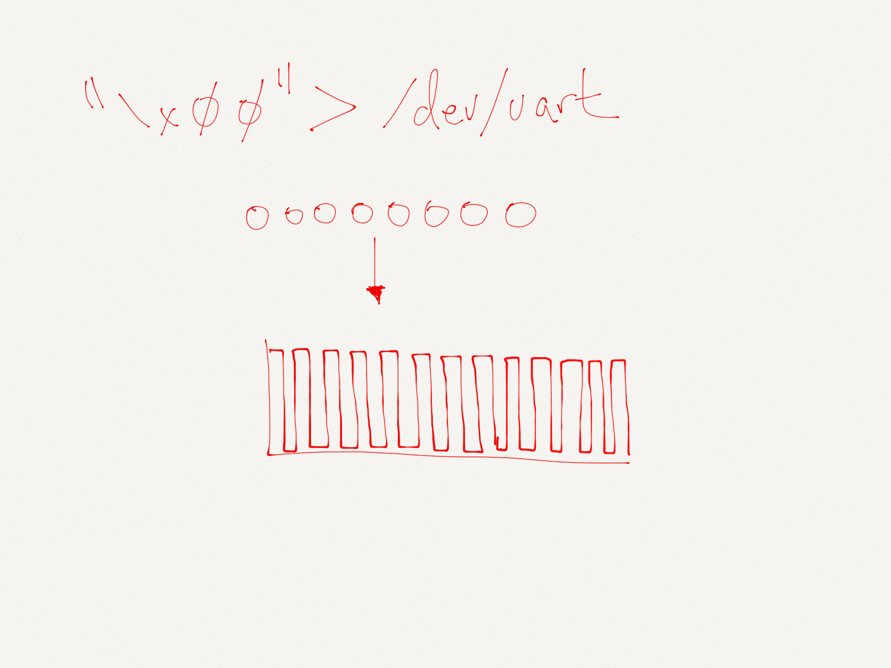
~ 1.8Mhz Carrier

Slide 92
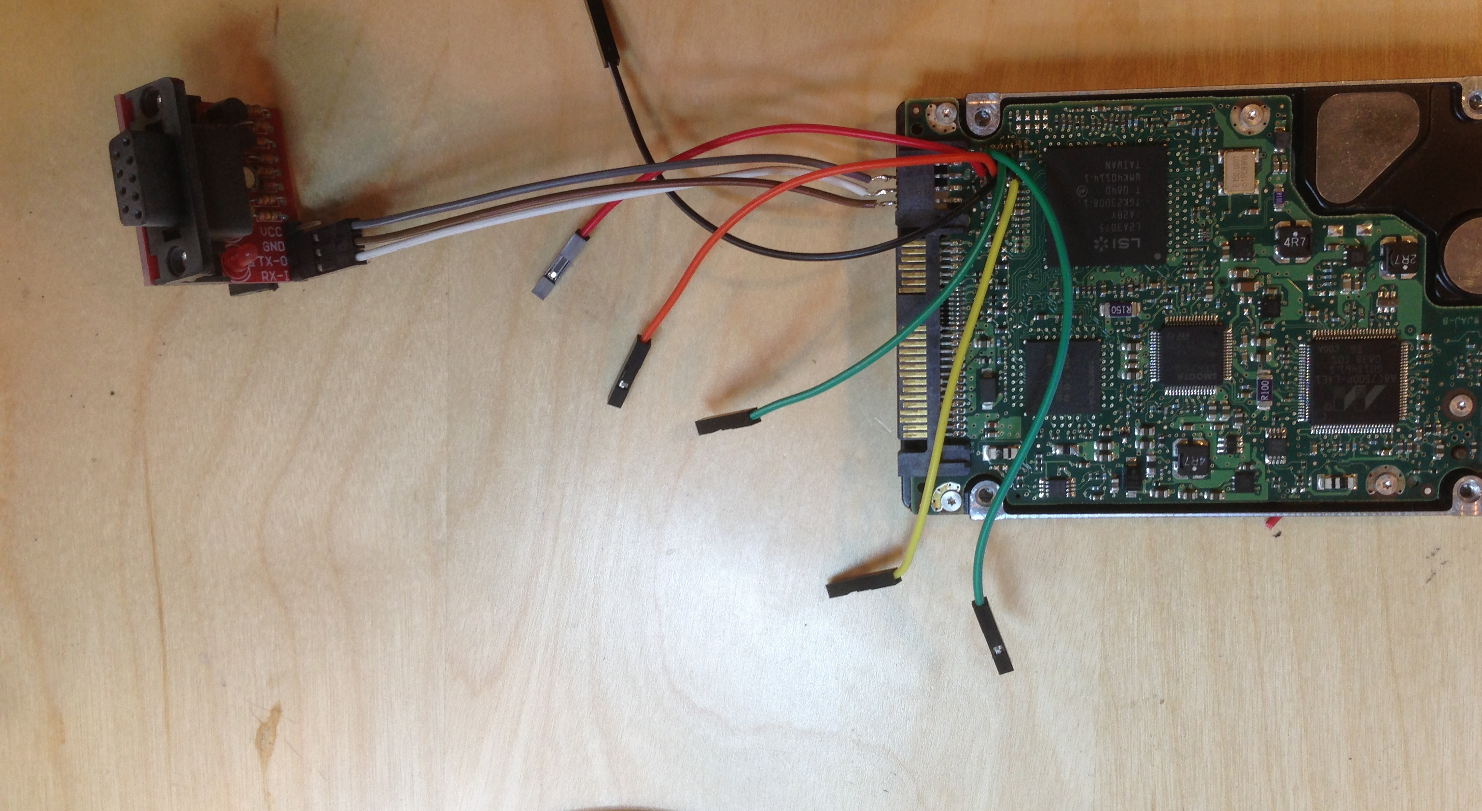
Other Potential Funtennas
UART on HDD
“Implementation and Implications of a Stealth Hard-Drive Backdoor”

Slide 93

Other Potential Funtennas
Ethernet Interface
UART on HDD
“Implementation and Implications of a Stealth Hard-Drive Backdoor”

Slide 94

Other Potential Funtennas
Ethernet Interface
UART on HDD
“Implementation and Implications of a Stealth Hard-Drive Backdoor”

Slide 96
Autotomic
Binary
Structure
Randomization

Slide 97
Autotomy
Binary
Structure
Randomization

Slide 98
Autotomic
Binary
Structure
Randomization

Slide 99

Idea 1: Remove code that should never execute

Slide 100
Idea 1: Remove code that should never execute
MGCP
VRRP
HSRP
EIGRP
HTTP/S
SIP
SCCP
DHCPServer
Etc, etc…

Slide 101
Idea 1: Remove code that should never execute
MGCP
VRRP
HSRP
EIGRP
HTTP/S
SIP
SCCP
DHCPServer
Etc, etc…
Lawful Intercept

Slide 102
Idea 1: Remove code that should never execute
MGCP
VRRP
HSRP
EIGRP
HTTP/S
SIP
SCCP
DHCPServer
Etc, etc…
Lawful Intercept
Feature not configured? Remove it from the firmware.

Slide 103
Idea 2: Use “empty space” in firmware for binary randomization

Slide 108
Autotomy
Binary
Structure
Randomization

Slide 109


Slide 110


Slide 111


Slide 112


Slide 113
Can be implemented using standard recursive graph traversal algorithm

Slide 114

Autotomy: Intractable for the general case, but feasible for most specific cases.
Specific addresses redacted –(

Slide 115
Autotomic
Binary
Structure
Randomization

Slide 116
Transform: Basic Block Split

Slide 117
Transform: Basic Block Swap

Slide 120
Demo
Removing HTTP & SSH servers from Cisco IOS
Cisco 1841, IOS 12.4

Slide 121



Demo
Removing HTTP & SSH servers from Cisco IOS

Slide 122

Demo

Slide 123
Binary Autotomy: Cisco IOS Features
HTTP
HTTP | SSH
HTTP|SSH|X.25|ATM
HTTP|SSH|X.25|ATM|SCP
X-axis: Levels of recursion
Y-axis: Bytes removed

Slide 124
Ang Cui | ang@cs.columbia.edu

